Slide 1


Slide 2
CryENGINE 3: reaching the speed of light
Anton Kaplanyan
Lead researcher at Crytek
Notes:
This talk is mostly about improvements in texture compression and deferred lighting on consoles.

Slide 3
Agenda
Texture compression improvements
Several minor improvements
Deferred shading improvements
Notes:
The talk consists of two major parts: texture compression and deferred lighting. Also several minor improvements will be mentioned.

Slide 4
Textures

Slide 5
Agenda: Texture compression improvements
Color textures
Authoring precision
Best color space
Improvements to the DXT block compression
Normal map textures
Normals precision
Improvements to the 3Dc normal maps compression
Notes:
There are two subparts of the texture compression part: compression of color/albedo textures and proposed improvements to normal maps compression.

Slide 6
Color textures
What is color texture? Image? Albedo!
What color depth is enough for texture? 8 bits/channel?
Depends on lighting conditions, tone-mapping and display etc.
16-bits/channel authoring is a MANDATORY
Major authoring tools are available in Photoshop in 16 bits / channel mode
All manipulations mentioned below don’t make sense with 8 b/channel source textures!
Notes:
Nowadays all color textures are mostly used as albedo textures in the lighting pipeline, despites of good old times of Doom and Quake.
Despite there are still many engines with precomputed light maps and even complete prebaked lighting solutions (e.g. Rage from id software), majority of modern engines try hard to stick to the most robust dynamic lighting pipeline in order to provide the most convenient tools for artists, thus simplifying the game development process.
So the color textures for the latter engines mostly represent the albedo of the surface it describe.
Thus, the color depth and the color space of these textures become an important discussion topic in this talk.
The very first and important step is to change the texture authoring pipeline to the higher precision in order to be able to manipulate with source texture with no precision loss after it’s been authored once. So we use a 16 bits/channel mode in Photoshop for texture authoring. This allows us to change the color space or histogram of the texture with no consequences both in the Photoshop and in our in-house texture processing tools.
This mode has mostly the same authoring options as the usual 8 bits/channel sRGB authoring mode. That means that the switch is mostly transparent for artists.
The manipulations proposed on the following slides might make the quality worse if the source texure is 8 bits/channel! So it is very important to have a source texture authored in 16bits/channel from the very beginning.

Slide 7

Histogram renormalization
Normalize color range before compression
Rescale in shader: two more constants per texture
Or premultiply with material color on CPU
Notes:
The first proposed manipulation is the color range renormalization.
Usually artists do not care about the quantization artifacts produced by block compression and/or low-precision quantization (that happens e.g. in DXT block compression). The most important point in authoring process is to achieve a similar looking texture in a usual game lighting. However dark textures might show very noticeable and disturbing artifacts under strong HDR lighting conditions.
Thus we decided to introduce a range renormalization for color textures behind the scenes. That significantly reduces the color banding and deviation introduced by 5:6:5 quantization and block compression of DXT format.
We store the original minimum and maximum limits into the resulting texture in order to be able to reconstruct the source texture created by the artist in the shader. That means that for each renormalized texture we set two additional shader constants in order to rescale the results of texture lookup.

Slide 8
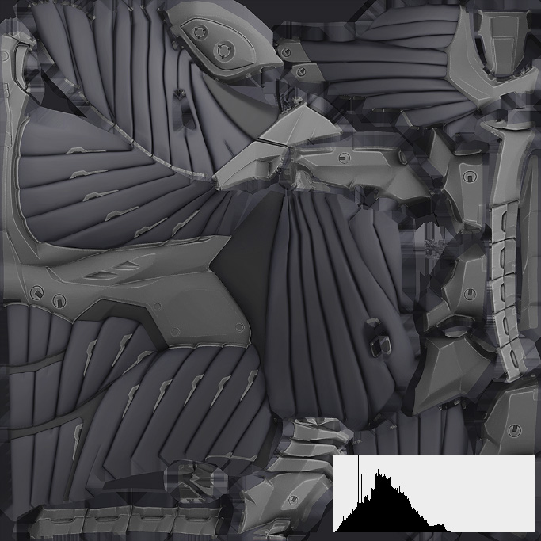
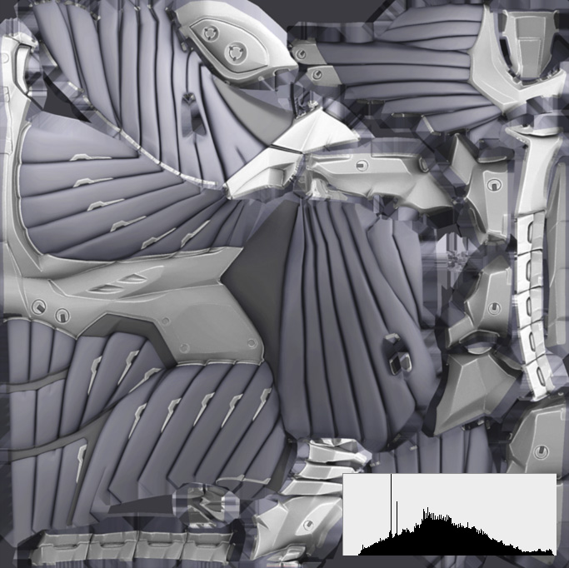
Histogram renormalization
Notes:
Here is the result of renormalization and the corresponding histograms of the original and the renormalized textures.
Note that the renormalization of 8b/ch source texture would produce a quantization in the renormalized histogram, thus leading to a larger color distortion during 5:6:5 quantization stage of DXT compression.

Slide 9
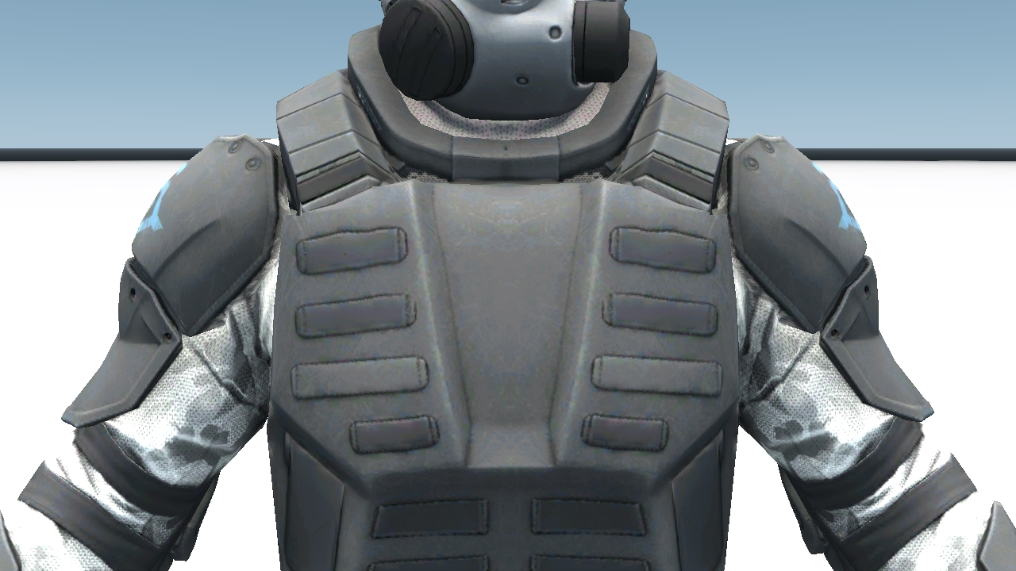

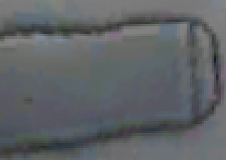
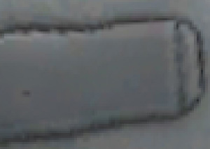
Histogram renormalization example
DXT w/o renormalization
DXT with renormalization
Notes:
The left most image shows the results for simple DXT-compressed texture under strong lighting conditions. On the right most one there are results for the renormalized and then DXT-compressed texture. Note that the blocky color artifacts are significantly reduced.
The texture appearance is not changed due to reconstruction of original range in the shader.

Slide 10
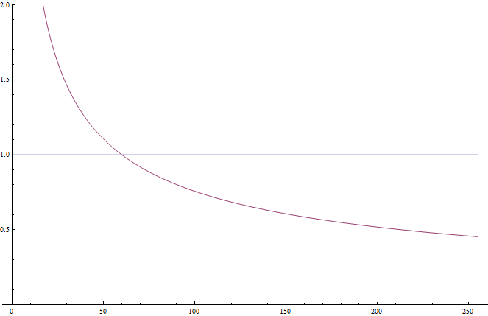
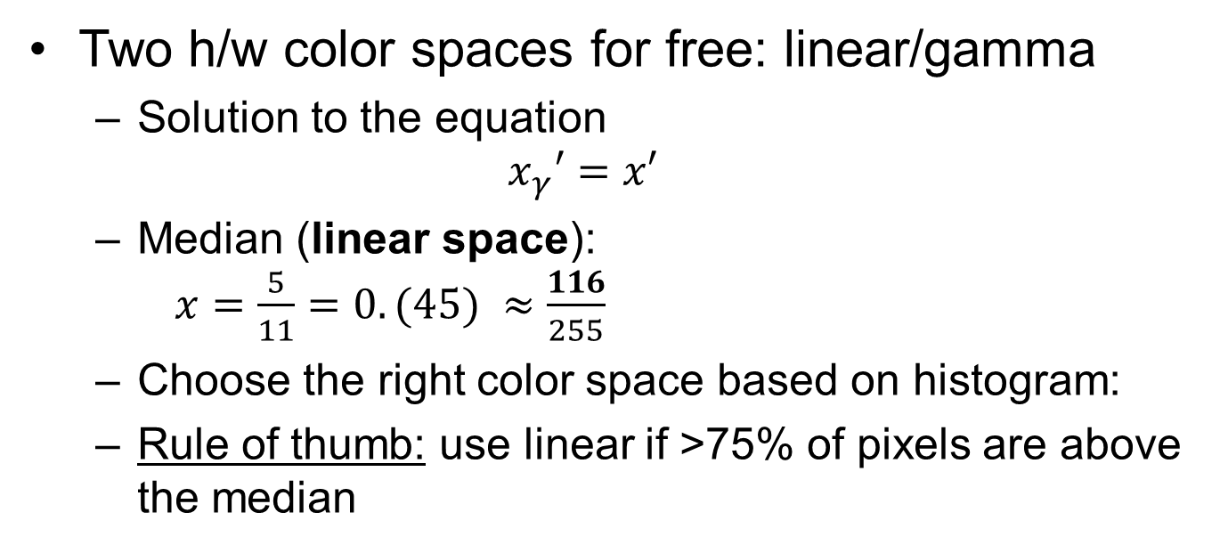
Gamma vs linear space for color textures
Two h/w color spaces for free: linear/gamma
Solution to the equation $x_{γ}′=x′$
Median (linear space): $x=\frac{5}{11}=0.(45) ≈\frac{116}{255}$
Choose the right color space based on histogram:
Rule of thumb: use linear if >75% of pixels are above the median
Notes:
The most of texture authoring software work in sRGB space. This is the native space of the display and it is perfectly represented in 8 bits.
Also there is generally accepted opinion that the color textures should be stored in sRGB color space too.
The interesting fact that there are two color spaces supported natively for free in the modern GPU. That means we can easily jump from one to another with no performance impact.
That fact arises a very interesting question about the color density in each color space. The density of the color space shows the quantization interval for the considered color space for a particular color range. In order to answer this question we can solve the equation of densities deduced from comparing the derivatives of each color space transformation in linear space.
The color transformation for linear space is obviously an identity transformation. The transformation from gamma space is a power function.
By solving this equation we can acquire the resulting density median for these color spaces. It shows the point of equal density of both linear and gamma space. This point is in the linear space. This means that the linear space has better precision above the value 116/255. And the gamma space is more precise below it.
So, we use the more appropriate color space for each particular texture judging by the texture’s histogram.
The rule of thumb that works for us is to switch to linear color space each time the number of texels above the median point in the texture is more than 75%.

Slide 11
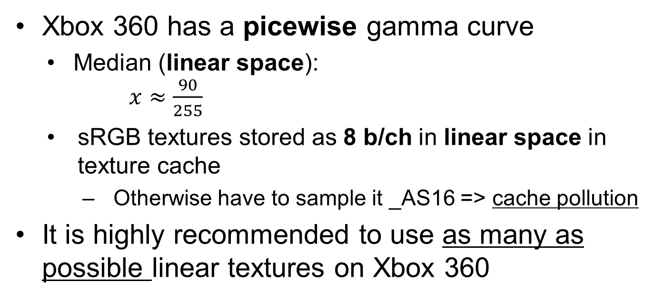
Gamma vs linear space on Xbox 360
Xbox 360 has a picewise gamma curve
Median (linear space): $x≈\frac{90}{255}$
sRGB textures stored as 8 b/ch in linear space in texture cache
Otherwise have to sample it _AS16 => cache pollution
It is highly recommended to use as many as possible linear textures on Xbox 360
Notes:
It is also generally correct for Xbox 360. However we need to take into account a different gamma curve used by Xbox’s GPU. It is a piecewise linear approximation to the power function of gamma transformation.
This shifts the choice of color space even more towards the linear space. The median is lower for piecewise linear gamma curve: 90/255 (in linear space). That means it is 25/255 in gamma space! So, keeping the rule of thumb the same (if >75% texels are above the median) leads us to the conclusion that the majority of textures could be beneficially stored in linear space for this platform.
On the other hand it solves another very important issue of the Xbox 360’s GPU related to gamma-space textures automatically. Every time the texture stored in gamma space is fetched in the shader, the GPU does the digamma and then stores the result back into 8 bits into the texture cache. This is a default behavior and it definitely introduces a great precision loss. In order to avoid the unwanted quantization, one could customize the texture format and specify the desired filtering precision by adding _AS16 suffix to the format (see the Xbox 360 documentation for more information). But that would definitely lead to much higher texture cache pollution and a consequent performance degradation.
However storing the majority of textures in linear space for this platform definitely solves this issue and further improves the color precision.
So as a conclusion we’d like to highly recommend using linear space textures for Xbox 360.

Slide 12



Gamma / linear space example
Source image (16 b/ch)
Gamma (contrasted)
Linear (contrasted)
Notes:
This is an example bright gradient texture (all colors are above the median) stored in 16 b/ch shown on the left most image. The middle image shows the same texture stored in gamma space and exaggerated in order to show the color banding on the usual display. The right most image shows the original texture stored in linear space with the same exaggeration.
It clearly shows the benefit of storing the bright textures in linear space. Note that this exaggeration could easily happen under some strong and/or contrast lighting conditions and using contrast tone mapping operator, like a filmic tone mapping.

Slide 13
Normal maps precision
Artists used to store normal maps into 8b/ch texture
Normals are quantized from the very beginning!
Changed the pipeline to ALWAYS export 16b/channel normal maps!
Modify your tools to export that by default
Transparent for artists
Notes:
The rest slides of the texture compression part of the talk are devoted to the compression of normal maps.
Historically, normal maps are being represented as a color maps. However the recent research in this area showed that the precision required to represent normals is much higher and heavily depends on the lighting conditions and the material properties.
As normal maps are usually a result of the matching process of low-poly and high-poly model, it is always possible to extract the normals of a very high precision.
Thus we recommend to modify the exporting tool you use in order to produce a 16bits/channel uncompressed normal map in order to be compressed further. This is a very important step, as the 8bits/channel normal maps introduce a huge error from the very beginning.

Slide 14
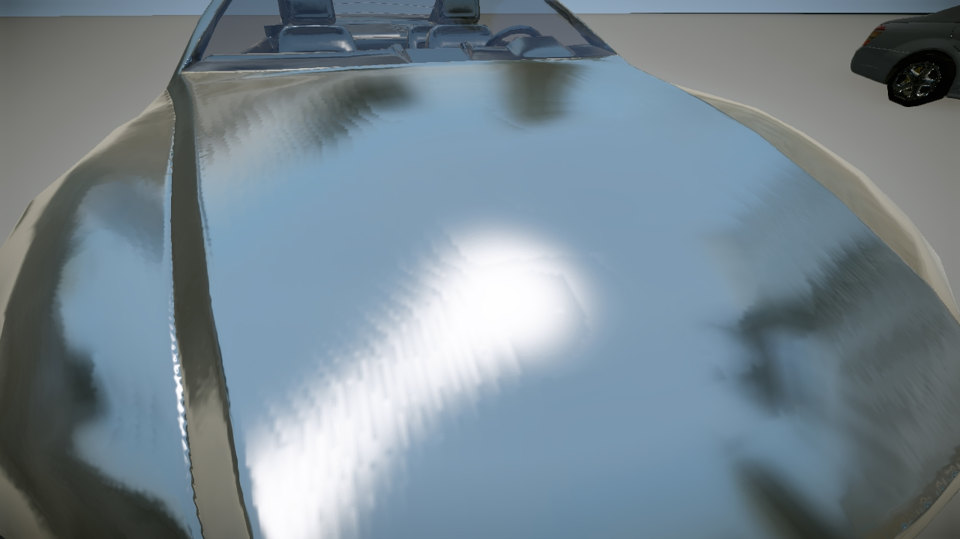
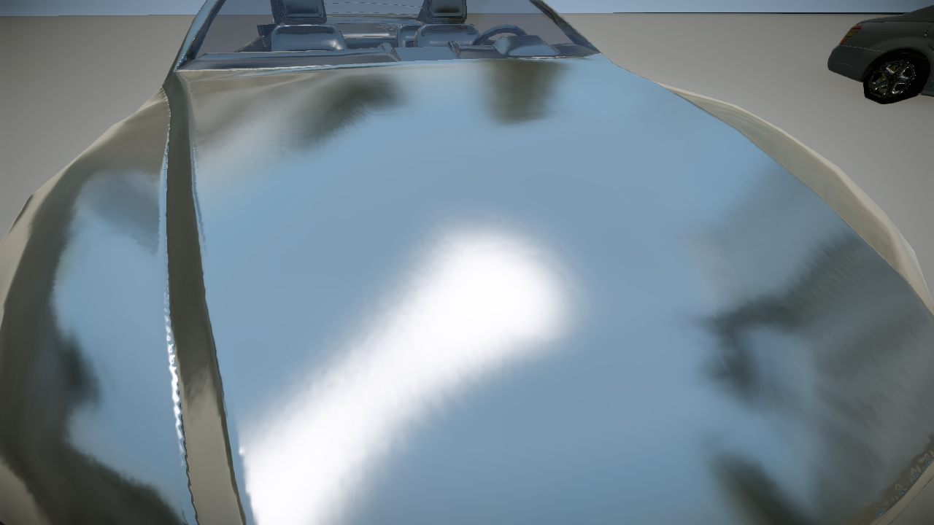
16-bits normal maps example
3Dc from 8-bits/channel source
3Dc from 16-bits/channel source
Notes:
This is an example of quantization artifacts introduced by storing source normal maps in 8b/ch format. As you can see, even the 8b/texel 3Dc compression gives much better results with 16b/ch, as it introduces artifacts only at the compression stage. However with 8b/ch normal maps the quantization error is accumulated from both 8b/ch quantization and the quantization introduced by the 3Dc compression.

Slide 15
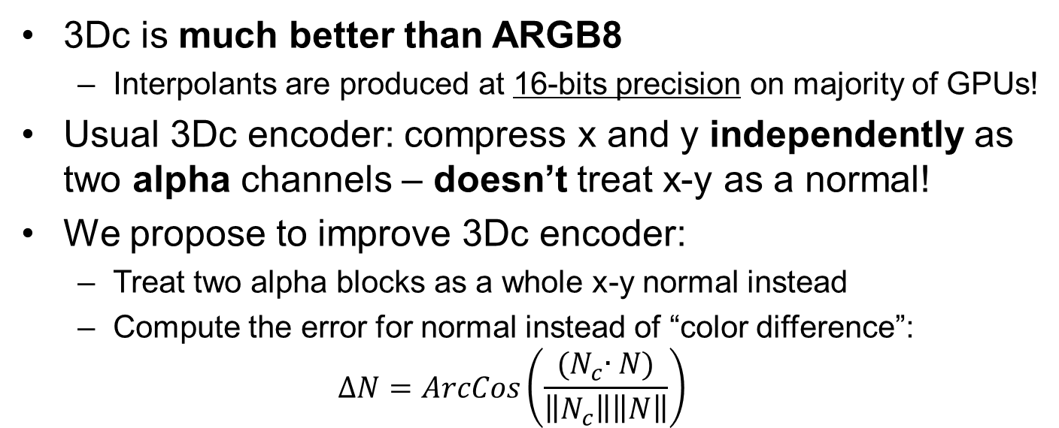
3Dc encoder improvements
3Dc is much better than ARGB8
Interpolants are produced at 16-bits precision on majority of GPUs!
Usual 3Dc encoder: compress x and y independently as two alpha channels – doesn’t treat x-y as a normal!
We propose to improve 3Dc encoder:
Treat two alpha blocks as a whole x-y normal instead
Compute the error for normal instead of “color difference”:
$$∆N=ArcCos\left(\frac{{(N}_{c}∙N)}{\left\|N_{c}\right\|\left\|N\right\|}\right)$$
Notes:
Also we propose an improvement to the 3Dc encoder. The usual 3Dc encoder encodes the normal map into a block-compressed two-channeled format. Each block consists of two alpha channel blocks of DXT5 format leading to 8bit/texel compression.
However the precision of data represented with 3Dc compressed block can exceed the precision of the ARGB8 format. The reason is that the majority of GPUs compute the interpolated values between two anchors in higher precision rather than 8 bits. E.g. The precision of interpolated values on Xbox 360 is 16 bits. This leads us to the point that the source uncompressed normal map should be stored definitely with the precision higher than 8b/ch! However this change should be also reflected into the 3Dc encoder.
Besides that, all existing 3Dc encoders perform the block compression of each of two channels separately, treating each block as a usual alpha block of DXT5 texture.
However while compressing normals, the error should be computed differently from alpha compression. Besides that the correlation between x and y channel of 3Dc block should be reflected in that error.
We propose to use a common error to measure directional deviations: $∆N=ArcCos\left(\frac{{(N}_{c}∙N)}{\left\|N_{c}\right\|\left\|N\right\|}\right).$So, after two candidate pairs of anchors for a 3Dc block are chosen, the normals are decompressed, the z component is reconstructed and the error between the source and the compressed normals is measured.

Slide 16
3Dc encoder improvements, cont’d
One 1024x1024 texture is compressed in ~3 hours with CUDA on Fermi!
Brute-force exhaustive search
Too slow for production
Notice: solution is close to common 3Dc encoder results
Adaptive approach: compress as 2 alpha blocks, measure error for normals. If the error is higher than threshold, run high-quality encoder
Notes:
However using this error we need to excess all the possible pairs of (x,y) anchors. That correlation complicates and slows down the compression process. The performance of 3Dc compression becomes production-unfriendly.
But as it was noticed during the development, the solution found by a common 3Dc encoder during the compression of separate alpha-blocks, is very close to the solution with the best error. Besides that, the “common solution” is the best solution in many situations.
So, we propose an adaptive approach for the 3Dc encoding:
Compress the block with a usual 3Dc compression approach
Measure the directional deviation with the proposed error
If the error is higher than some threshold, initiate the improved compression stage.
Note that we use an exhaustive search only around the “common solution”. We use [v-4/255;v+4/255] interval for the exhaustive search, which is proved to be enough.
Thus the performance overhead introduced is minimal.

Slide 17



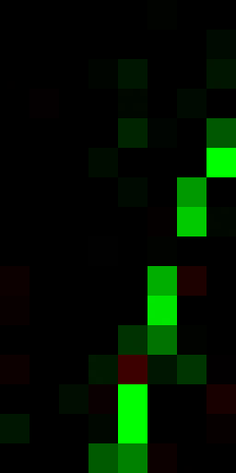
3Dc improvement example
Original nm, 16b/c
Common encoder
Proposed encoder
Difference map
a
b
c
d
Notes:
Here is a comparison of the 3Dc encoder (image b) and the improved 3Dc encoder (image c). As the differences are hardly visible in a narrow color space of display, we also provide a difference map (d). This map shows a pixel in green if our method has smaller error compared to usual 3Dc encoder. The intensity is the difference in errors, amplified by 5. Also it shows a pixel in red if our method provides a worse error for it. As you can see our method is mostly surpasses the usual 3Dc encoder.
However this is a pure theoretical comparison. Let’s see how does it look in practice.

Slide 18
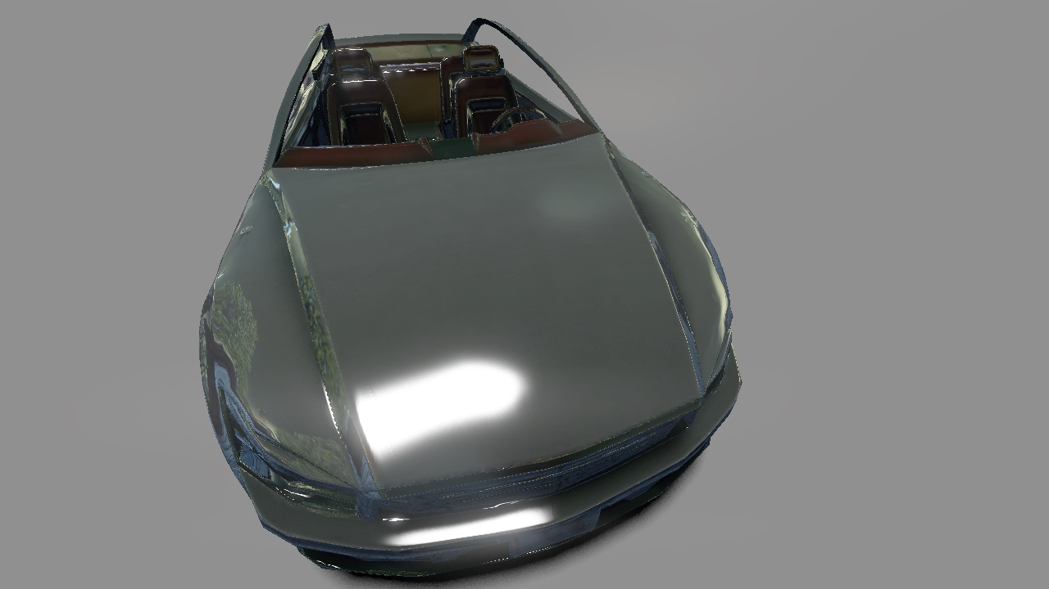

3Dc improvement example
“Ground truth” (RGBA16F)
Notes:
This is an image of the car rendered with the uncompressed normal map, stored in RGBA16F format. As we mentioned before, the ARGB8 format is not sufficient for the comparison with 3Dc format, as it introduces more quantization than 3Dc.

Slide 19


3Dc improvement example
Common 3Dc encoder
Notes:
This is the image produced using a usual 3Dc encoder. You see the quantization on the hood leading to the banding of specular reflections.

Slide 20


3Dc improvement example
Proposed 3Dc encoder
Notes:
And this image is rendered with the improved 3Dc encoder. As you can see, the specular reflections are much less banded.
Note that the format remains the same (3Dc)! The improvements are done only on the encoder’s side.

Slide 21
Different improvements

Slide 22
Occlusion culling
Use software z-buffer (aka coverage buffer)
Downscale previous frame’s z buffer on consoles
Use conservative occlusion to avoid false culling
Create mips and use hierarchical occlusion culling
Similar to Zcull and Hi-Z techniques
Use AABBs and OOBBs to test for occlusion
On PC: place occluders manually and rasterize on CPU
CPU↔GPU latency makes z buffer useless for culling
Notes:
We have a low-resolution software depth buffer since CryENGINE 2 and Crysis 1.
This significantly reduces both CPU and GPU workload, as we skip the complete processing and preparation for rendering for culled objects.
However a complete software culling is less efficient, as we are able to render only some very small and sparse part of the real scene on the CPU.
However we improved this approach on consoles.
Because of a thin GPU-CPU intercommunication layer (fast memory busses, no API limitations, no virtualization), we are able to retrieve the z buffer from GPU with only one frame delay.
We downscale the z buffer on GPU using a max() filter in order to preserve a conservative visibility detection. On Xbox 360 we untile the downscaled depth buffer on CPU.
Afterwards we construct mip levels with a minimum and maximum filter in order to construct a hierarchical representation of the scene depth. This is a rather important acceleration structure for culling. A similar algorithm is used in a vast majority of modern GPUs.
Then during the visibility detection we project an AABB or OOBB of the object into the screen space and detect the necessary mip level.
If the object is completely occluded by the minimum level of this mip, we cull this object out.
If the object is in front of the maximum bound of the mip, it’s definitely not occluded.
If the object’s depth bounds intersect the minimum-maximum interval of this mip, we intersect it with the depth information from the higher mip in order to detect a precise visibility.
However on PC we use a complete software solution with some hand-placed low-poly proxies made by level designers. This is due to the high latency in the GPU-CPU intercommunication, which leads us to a 3-frames delay. This is unacceptable for culling.

Slide 23
SSAO improvements
Encode depth as 2 channel 16-bits value [0;1]
Linear detph as a rational: depth=x+y/255
Compute SSAO in half screen resolution
Render SSAO into the same RT (another channel)
Bilateral blur fetches SSAO and depth at once
Volumetric Obscurrance [LS10] with 4(!) samples
Temporal accumulation with simple reprojection
Total performance: 1ms on X360, 1.2ms on PS3
Notes:
We use downscaled z-buffer.
During downscaling, we encode the linear depth value into two channels of the ARGB8 texture.
The rest channels we use for SSAO computation of current frame and the temporally accumulated results.
We compute the SSAO in half resolution of the screen. Then we do a bilateral upscaling onto the screen.
We use Volumetric Obscurrance[LS10], which allowed us to lower down the number of samples to 4!
Of course this approach is supplemented by temporal accumulation in order to provide more samples over time. However we don’t use sophisticated cache rejection schemes, rather a simple reprojection from previous frame.
Thus the performance achieved is around 1 ms on both consoles.

Slide 24
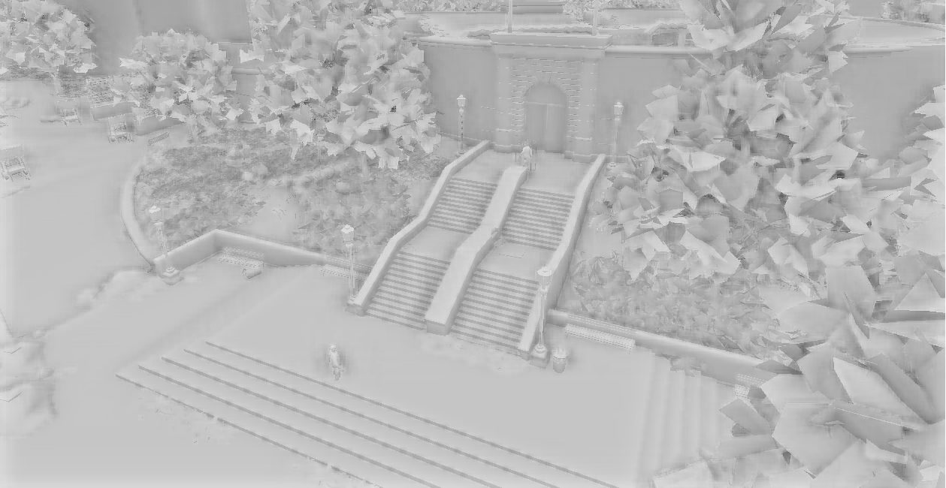
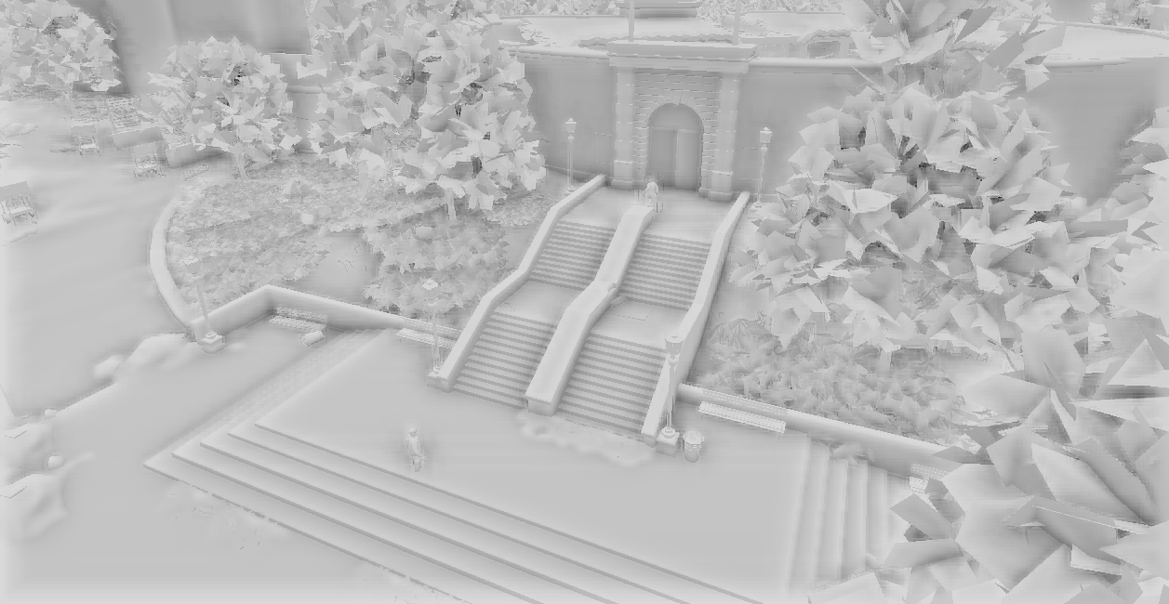
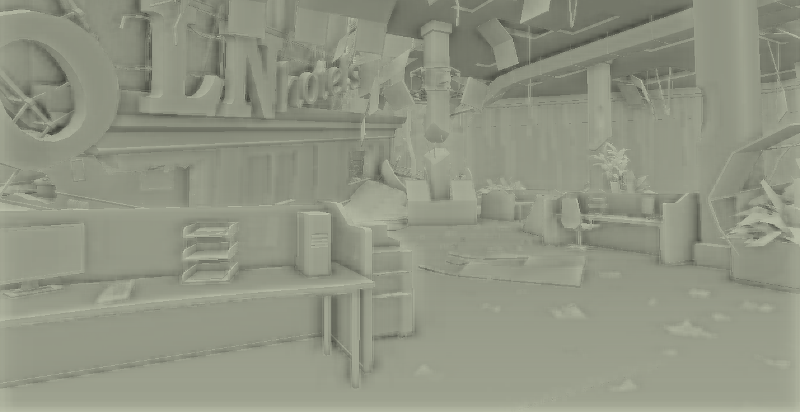
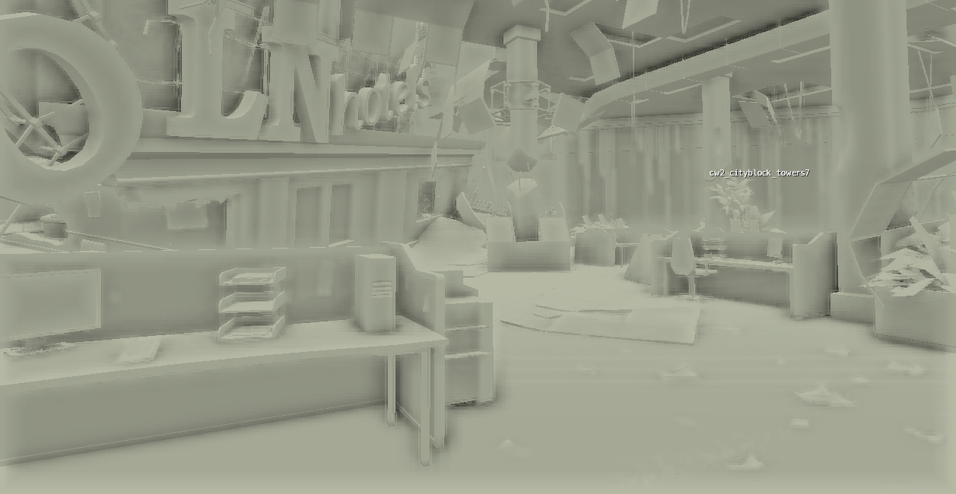
Improvements examples on consoles
Old SSAO technique
Improved SSAO technique

Slide 25
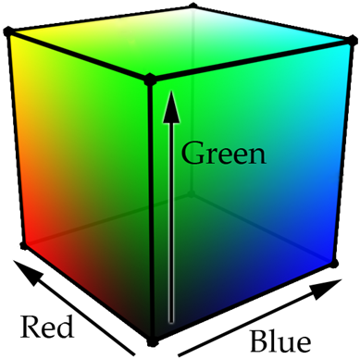
Color grading
Bake all global color transformations into 3D LUT [SELAN07]
16x16x16 LUT proved to be enough
Consoles: use h/w 3D texture
Color correction pass is one lookup
newColor = tex3D(LUT, oldColor)
Notes:
The color transformations are a very important tools for artists.
However creating the whole infrastructure of sophisticated professional filters and other tools is usually an unaffordable task for the game engine.
The vast majority of image-wide filters (like color correction, contrast, brightness, levels, selective colors etc.) can be represented as a mapping of an rgb cube into another rgb cube.
This mapping can be represented as a 3D Look-Up Table [Selan07].
Taking into account the color-space consistency of all filters, the size of this LUT can be very small.
After doing some experiments, we figured out that the size of 16x16x16 is more than enough for the majority of color transformations.
Also it is possible to use the GPU-aided 3D textures, which speeds up the color correction on consoles, making it only one texture look up.

Slide 26
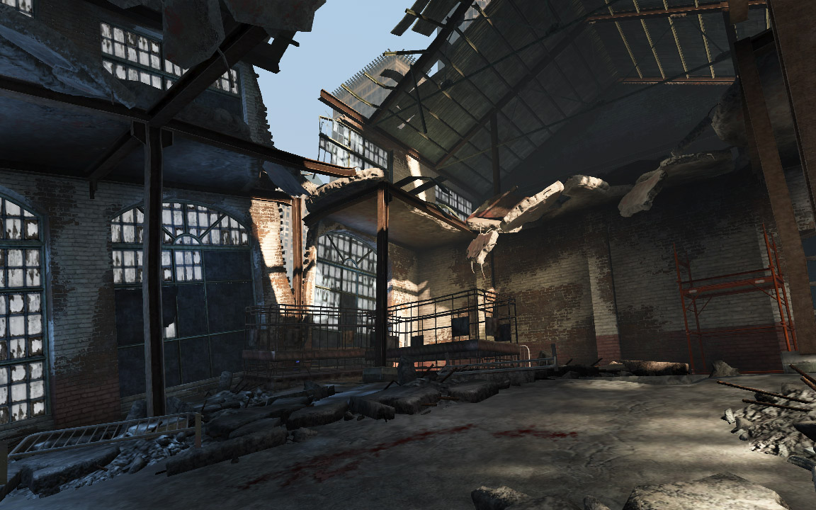
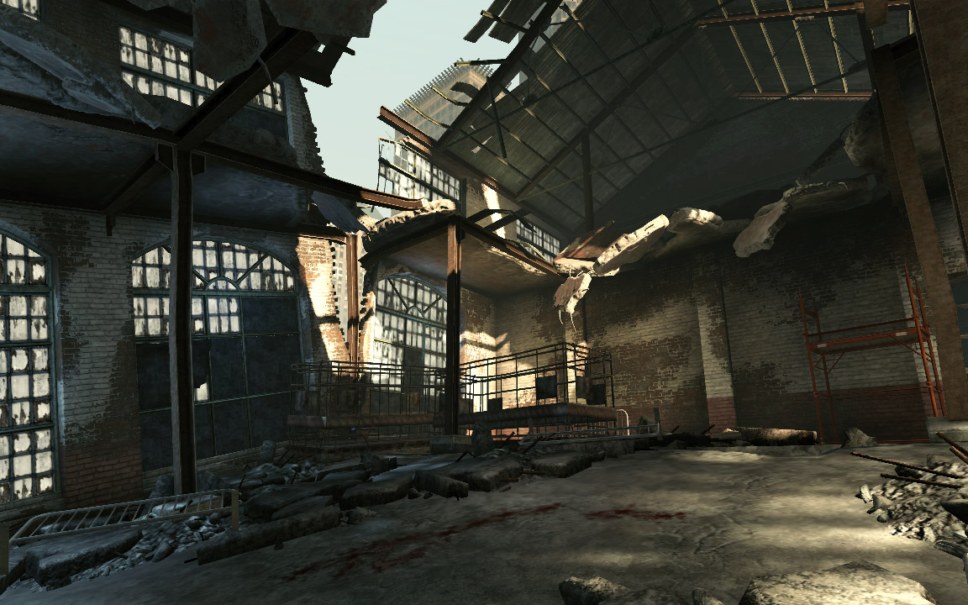
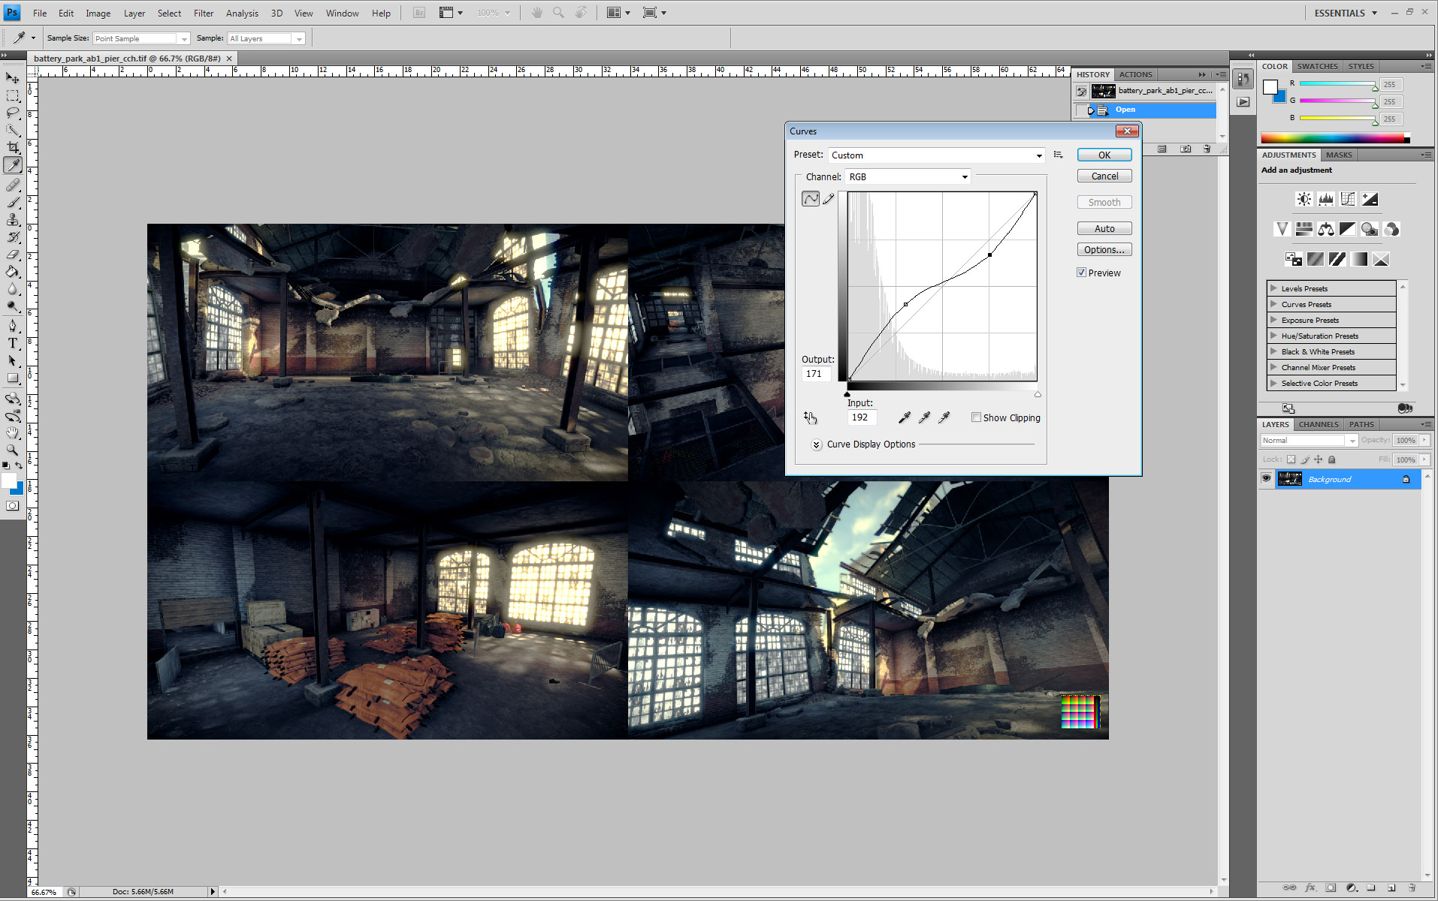
Color grading
Use Adobe Photoshop as a color correction tool
Read transformed color LUT from Photoshop
CryENGINE 3
CryENGINE 3
Adobe Photoshop
Notes:
Another very important part of the color grading is to provide a convenient workflow.
For that purposes we unwrap the 16x16x16 identity LUT into 16 slices and bake it into the source image (which is usually a game screenshot).
This is a small chart, that consists of 16 slices, 16x16 each. This chart initially maps each rgb color to itself, which is an identity transformation for the source screenshot.
After artist has finished working on the color correction of the image/screenshot, we read back the chart and save it as a texture LUT.
Afterwards we load this LUT into the engine (2D or 3D texture, depending on platform and API limitations) and perform the full-screen color transformation with it.
This was an artist has completely identical results to what he/she wanted to achieve in the image authoring tool.

Slide 27
Color chart example for Photoshop
Notes:
This is an example of the image, which consists of several screenshots of the same location and one small color chart in the corner.
This color chart serves as a probe for all color transformation and post processes an artist applies onto the image.

Slide 28
Deferred pipeline
Notes:
This part of the talk is devoted to the deferred pipeline in CryENGINE 3.
Performance challenges will be discussed as well as some new solutions and techniques.

Slide 29
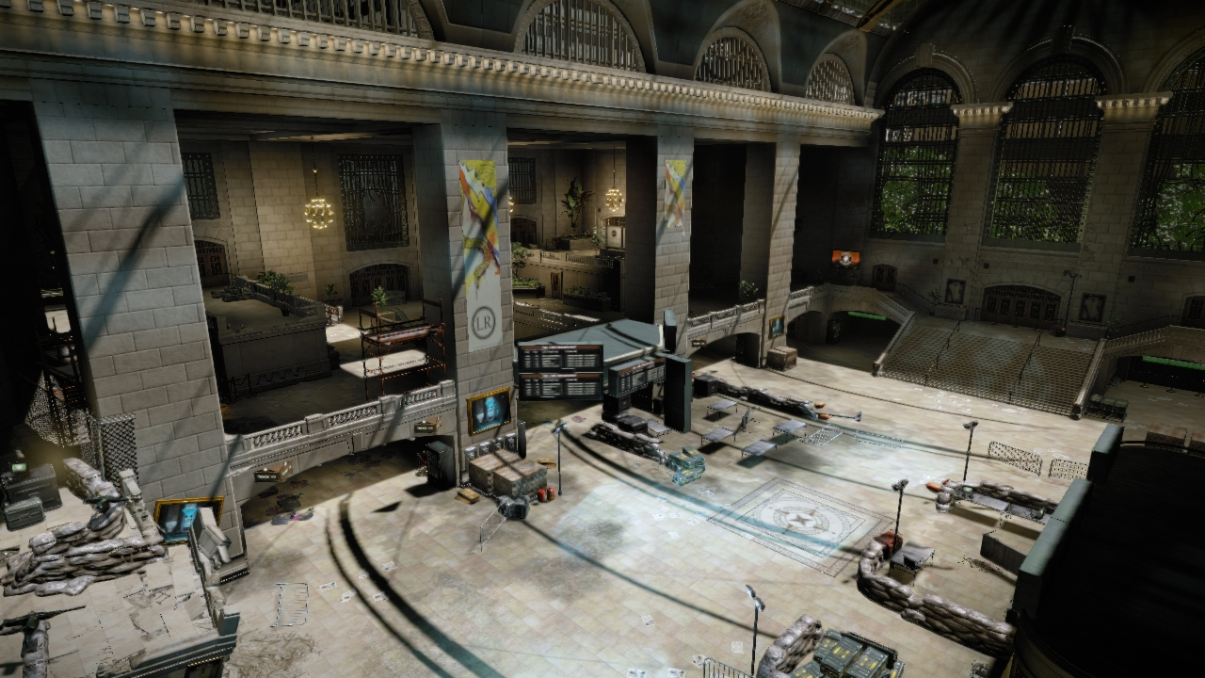
Why deferred lighting?
Scene in the Crysis 2 level
Notes:
This is an example screenshot of a real level in Crysis 2.

Slide 30
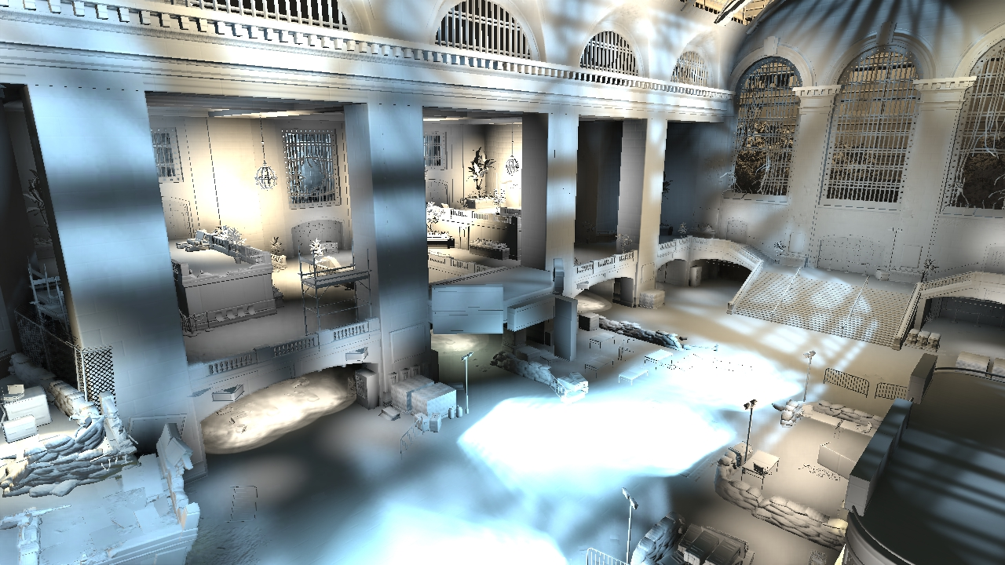
Why deferred lighting?
Diffuse lighting term
Notes:
This is the diffuse lighting buffer corresponding to the screenshot.

Slide 31
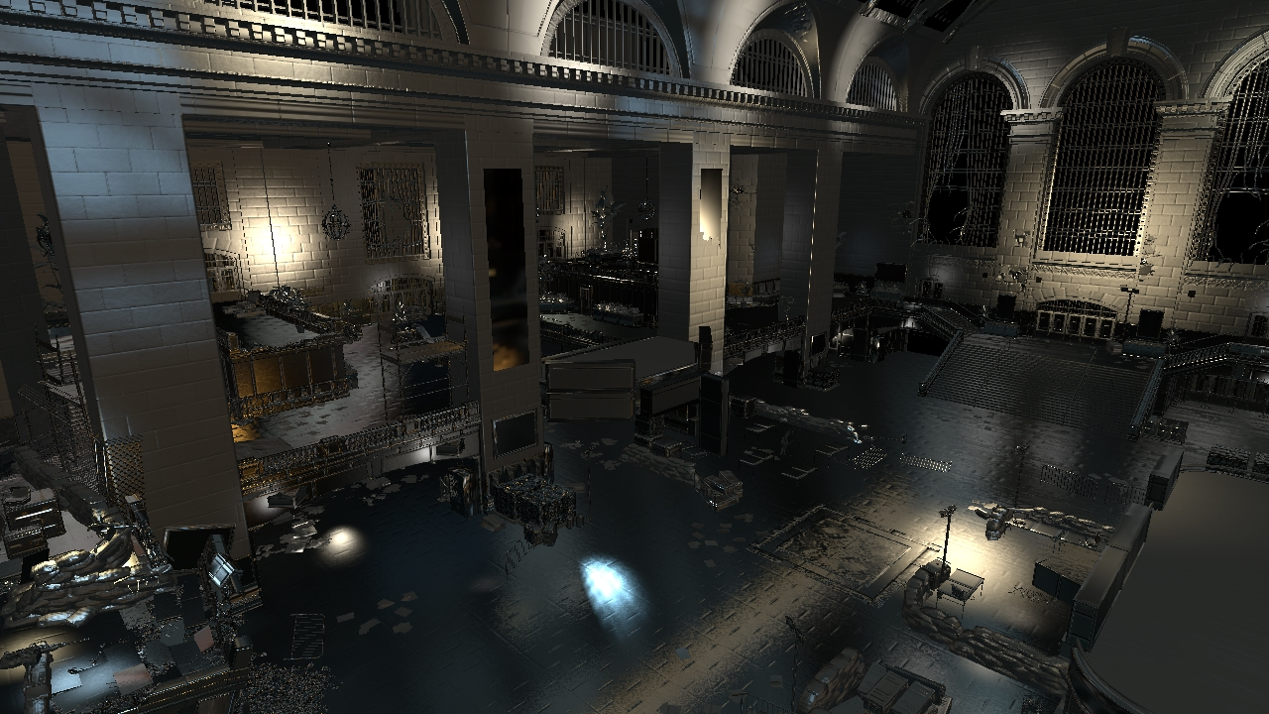
Why deferred lighting?
Specular lighting term
Notes:
This is the specular lighting buffer corresponding to the screenshot.

Slide 32
Introduction
Good decomposition of lighting
No lighting-geometry interdependency
Cons:
Higher memory and bandwidth requirements
Notes:
The deferred approach is widely known for its good property of decomposing the lighting depth from the geometry granularity.
That means that the geometry is rendered before the actual lighting is done.
However, we have to store screen-space “fragments” for the deferred lighting into a Geometry buffer (G-Buffer). This leads to much higher bandwidth.

Slide 33
Deferred pipelines bandwidth
Notes:
This is a schematic chart showing the trade-off between the number of attributes stored per fragment versus the shading flexibility and materials variety.
The forward shading is here for reference, as it looks like a perfect solution (the highest materials variety vs the lowest bandwidth), however the forward lighting does not decouple the complexity. That is inappropriate for modern games with very complicated layered lighting, as shown before.
Thus there are three widely-known types of deferred rendering pipeline:
Classic deferred shading (S.T.A.L.K.E.R. etc) [GPU Gems 2]. G-Buffer layout: depth, normal, glossiness, albedo, occlusion and material index – 112-144 bits/pixel
Full deferred lighting (aka Light Prepass) [Engel09]. G-Buffer layout: depth, normal, glossiness and albedo – 96 bits/pixel (best case)
Partial deferred lighting [Mittring09]. G-Buffer layout: depth, normal and glossiness – 64 bits/pixel.
However, shortening the layout comes with cost: material variety becomes more and more limited.

Slide 34
Major issues of deferred pipeline
No anti-aliasing
Existing multi-sampling techniques are too heavy for deferred pipeline
Post-process antialiasing doesn't remove aliasing completely
Need to super-sample in most cases
Limited materials variations
No anisotropic materials
Transparent objects are not supported
Notes:
There are also some fundamental limitations of the deferred pipeline on GPUs:
The anti-aliasing becomes a super-sampling: need to store the G-Buffer information per sample. Dramatically increases the bandwidth.
Arbitrary materials increase the amount of stored information per pixel significantly. That’s why the materials variety is usually very limited.
The transparent objects should be rendered into a “deep G-Buffer” in order to store all transparent layers for deferred shading/lighting. This is a similar problem to anti-aliasing.

Slide 35
Lighting layers of CryENGINE 3
Indirect lighting
Ambient term
Tagged ambient areas
Local cubemaps
Local deferred lights
Diffuse Indirect Lighting from LPVs
SSAO
Direct lighting
All direct light sources, with and without shadows
Notes:
In CryENGINE 3 we have the following layers of lighting:
Indirect lighting
Ambient term
Tagged ambient areas
Local cubemaps
Local deferred lights
Diffuse Indirect Lighting from LPVs
SSAO
Direct lighting
All direct light sources, with and without shadows
These layers are applied in the order enlisted above. However some of these layers are optional depending on the area and lighting artist’s setup.

Slide 36
G-Buffer. The smaller the better!
Minimal G-Buffer layout: 64 bits / pixel
RT0: Depth 24bpp + Stencil 8bpp
RT1: Normals 24 bpp + Glossiness 8bpp
Stencil to mark objects in lighting groups
Portals / indoors
Custom environment reflections
Different ambient and indirect lighting
Notes:
As it was described before, we use a minimal G-Buffer layout [Mittring09].
The layout consists of the depth (24bits), stencil (8bits), normal (24bits) and the glossiness (8bits).
We use stencil to mark objects that lay in different areas.
E.g. we mark objects that should receive different ambient in different indoor rooms with different stencil masks.

Slide 37
G-Buffer. The smaller the better, Cont’d
Glossiness is non-deferrable
Required at lighting accumulation pass
Specular is non-accumulative otherwise
Problems of this G-Buffer layout:
Only Phong BRDF (normal + glossiness)
No aniso materials
Normals at 24bpp are too quantized
Lighting is banded / of low quality
Notes:
The very important lighting parameter is the glossiness.
On one hand, it represents the specular power. Without this value the specular contribution from different lights cannot be accumulated together.
But on the other hand the glossiness together with the normal define a complete lobe of the Phong BRDF. Note that without the glossiness, the BRDF is undefined, thus the lighting cannot be performed.
However the consequent problem with this G-Buffer layout is the small variations of materials, limited by the Phong shading.
Another very important problem is the representation of normals in the G-Buffer. We store normalized world-space normals into RGB channels of the RGBA8 render target.
With this representation, the normals are stored with an insufficient precision.

Slide 38
Storing normals in G-Buffer
Notes:
This part it devoted to the new technique for storing normals in 24-bits G-Buffer efficiently.

Slide 39
Normals precision for shading
Normals at 24bpp are too quantized, lighting is of a low quality
24 bpp should be enough. What do we do wrong? We store normalized normals!
Cube is 256x256x256 cells = 16777216 values
We use only cells on unit sphere in this cube:
~289880 cells out of 16777216, which is ~ 1.73 % ! !
Notes:
As it described before, with a current representation, the normals are stored with an insufficient precision.
That leads to banding artifacts with all sorts of normals-related shading, like diffuse lighting, environment reflection, specular lighting etc.
However talking from the information theory perspective, 24bpp should be enough to represent a direction (essentially a point on the sphere) very precisely.
Seems like we’re doing something wrong.
If we count how many values we use out of these 24 bits, it turned out that we use only values on the unit sphere out of a 3d grid 256x256x256. That leads us to the usage of around 2%!

Slide 40
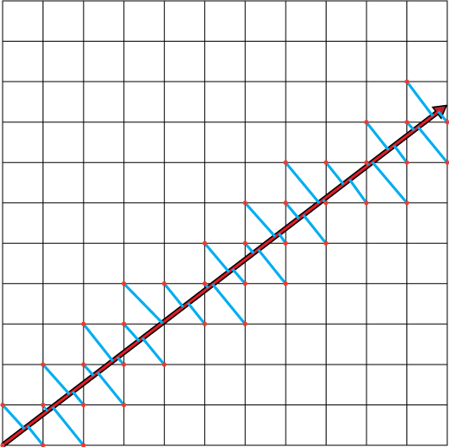
Normals precision for shading, part III
We have a cube of 256³ values!
Best fit: find the quantized value with the minimal error for a ray
Not a real-time task!
Constrained optimization in 3DDDA
Bake it into a cubemap of results
Cubemap should be huge enough (obviously > 256x256)
Notes:
We propose the new method to utilize all values inside this unit cube.
Having the original normal (=direction), we take each cell of the cube the normal ray intersects.
We compute the quantization error for every such a cell.
The quantization error tells us what would be the deviation of the center of the cell compared to the original normal direction.
That shows the error if we store this direction into that cell.
Using that, we find the cell with minimal deviation from the normal’s ray on the ray’s way.
Thus we find the best cell for some particular direction.
However finding this minimum is non-trivial brute-force search task, which cannot be done in real-time for each normal we want to store into G-Buffer.
Thus we decided to prebake the result of the search into a huge cubemap of directions. Each texel of the cubemap stores the distance to the best cell for the normal with this direction.
The cubemap’s face should be larger than 256x256 in order to provide fine-grained solutions for directions of normals.
The larger the cubemap the more precise the normals representation. However even a cubemap of 2k x 2k is already problematic for performance and memory on consoles.

Slide 41
Normals precision for shading, part III
Extract the most meaningful and unique part of this symmetric cubemap
Save into 2D texture
Look it up during G-Buffer generation
Scale the normal
Output the adjusted normal into G-Buffer
See appendix A for more implementation details
Notes:
However this cubemap has a lot of symmetry inside. The cubemap’s symmetry comes from the inherited symmetry of the task itself. Indeed, the best cell solution should be the same in all 8 octants. Also inside the octant there is a diagonal symmetry for the same reason.
Using that fact, we extracted the unique part of the cubemap and saved it into a small 512x512 2D texture. The emulation of cubemap lookup is done in the pixel shader. The detailed shader code and the texture itself you can find in the appendix of these slides.
The algorithm of outputting the normal into the G-Buffer is as follows:
Prepare the texture coordinates for 2D lookup and look up the distance to the best cell from the precomputed 2D texture
Scale the normalized normal by this value in order to fit it into the precomputed best cell
Output the scaled normal into the G-Buffer.

Slide 42
Best fit for normals
Supports alpha blending
Best fit gets broken though. Usually not an issue
Reconstruction is just a normalization!
Which is usually done anyway
Can be applied to some selective smooth objects
E.g. disable for objects with detail bump
Don’t forget to create mip-maps for results texture!
Notes:
This method has a lot of advantages.
It supports alpha-blending, as it becomes a blending between two unnormalized vectors, which is still linear and correct. However in case of alpha blending, we lose the best fit solution in the end. But it is not that important for the production, as the blending is mostly used for decals, smooth transitions and detail normal mapping, where the smoothness of normals is not an issue.
The reconstruction is extremely cheap (even for free): it is only one normalization, which is done anyway in most of engines because of unnormalized results provided by alpha blending.
It is backwards-compatible with storing normalized normals solution. That means that the best fit can be applied selectively per object, based on the reflectance, smoothness, presence of detail normal maps etc.
Also a small note on the performance: the mip maps for the 2D texture are essential, otherwise the texture cache thrashing becomes quickly apparent.

Slide 43
Storage techniques breakdown
Normalized normals:
~289880 cells out of 16777216, which is ~ 1.73 %
Divided by maximum component:
~390152 cells out of 16777216, which is ~ 2.33 %
Proposed method (best fit):
~16482364 cells out of 16777216, which is ~ 98.2 %
Two orders of magnitude more
Notes:
This is a small breakdown of the existing storage methods.
It shows how many bits it uses out of total number of 24 bits.
Both old techniques uses ~17 bits, which explains the low normals quality.
However the proposed technique uses almost the whole range of 24 bits, beating the old ones with almost two orders of magnitude.

Slide 44
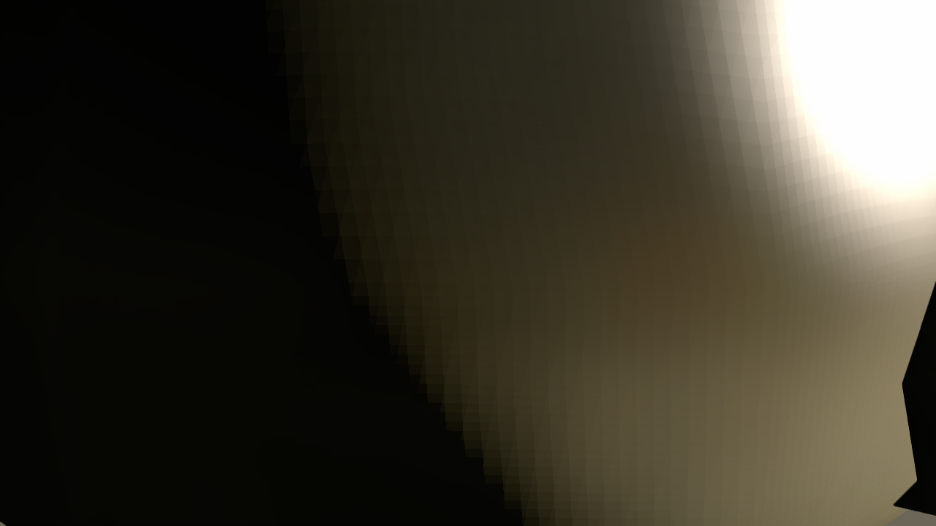
Normals precision in G-Buffer, example
Diffuse lighting with normalized normals in G-Buffer
Notes:
Here is a series of screenshots demonstrating the results of the new technique compared to old ones.

Slide 45

Normals precision in G-Buffer, example
Diffuse lighting with best-fit normals in G-Buffer
Notes:
Here is a series of screenshots demonstrating the results of the new technique compared to old ones.

Slide 46
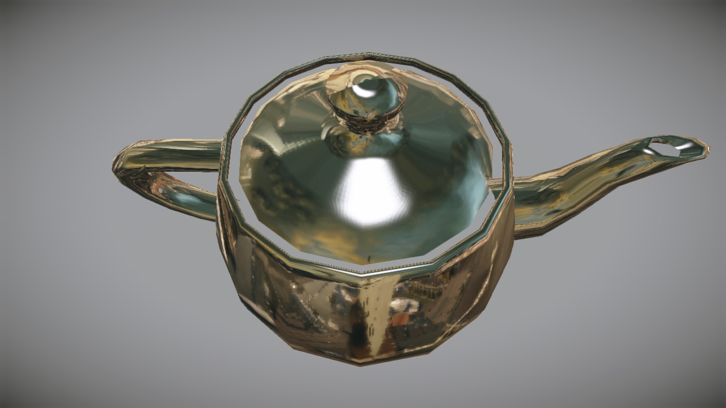

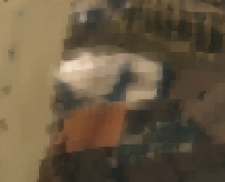
Normals precision in G-Buffer, example
Lighting with normalized normals in G-Buffer
Notes:
Here is a series of screenshots demonstrating the results of the new technique compared to old ones.

Slide 47
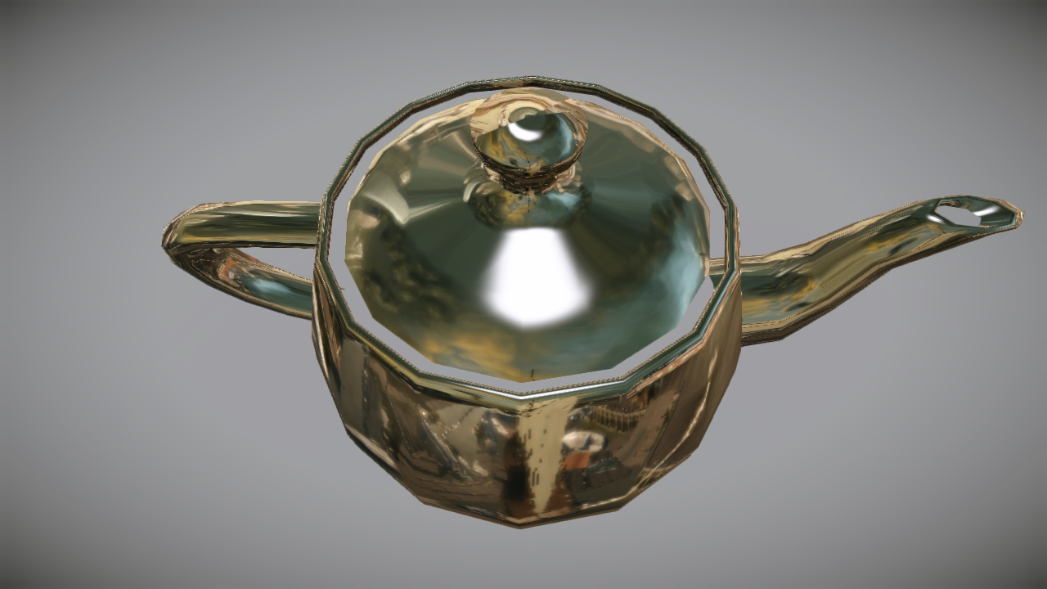

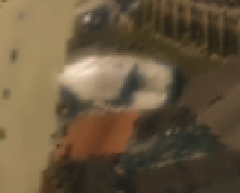
Normals precision in G-Buffer, example
Lighting with best-fit normals in G-Buffer
Notes:
Here is a series of screenshots demonstrating the results of the new technique compared to old ones.

Slide 48
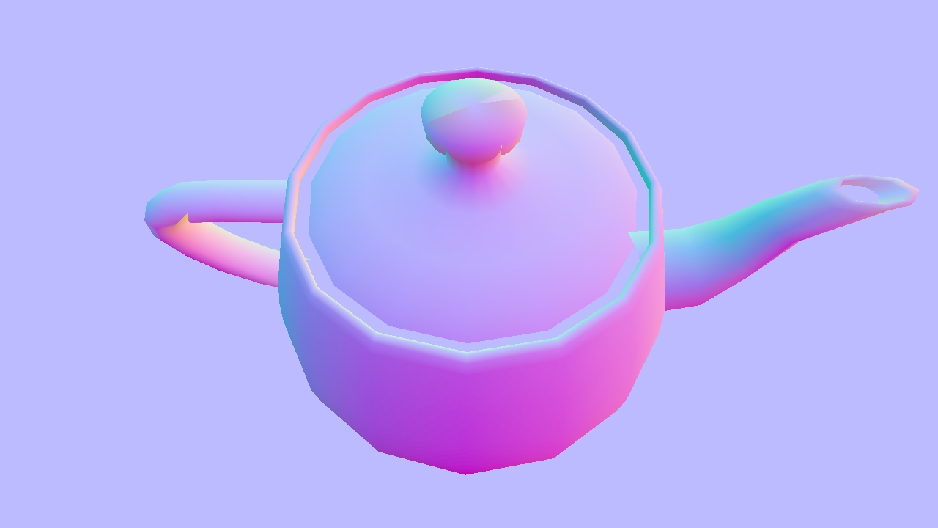


Normals precision in G-Buffer, example
G-Buffer with normalized normals
Notes:
Here is a series of screenshots demonstrating the results of the new technique compared to old ones.

Slide 49
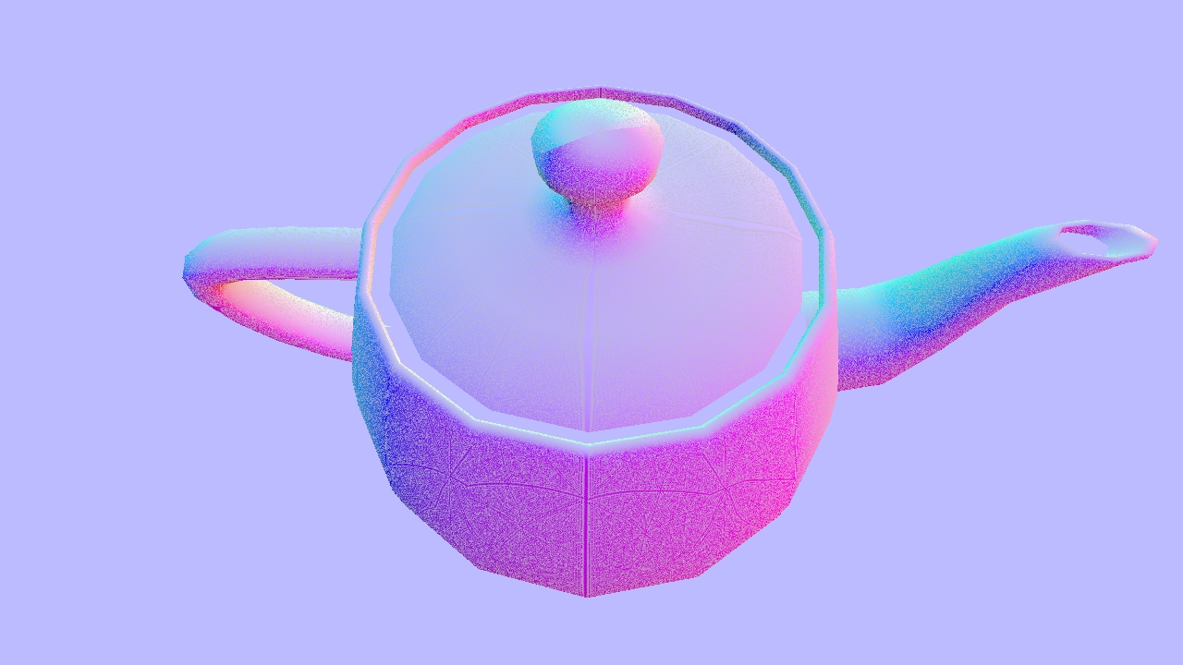

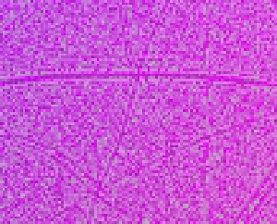
Normals precision in G-Buffer, example
G-Buffer with best-fit normals
Notes:
Here is a series of screenshots demonstrating the results of the new technique compared to old ones.

Slide 50
Physically-based BRDFs
Notes:
This part is devoted to the importance of BRDF normalization and energy conservation.

Slide 51
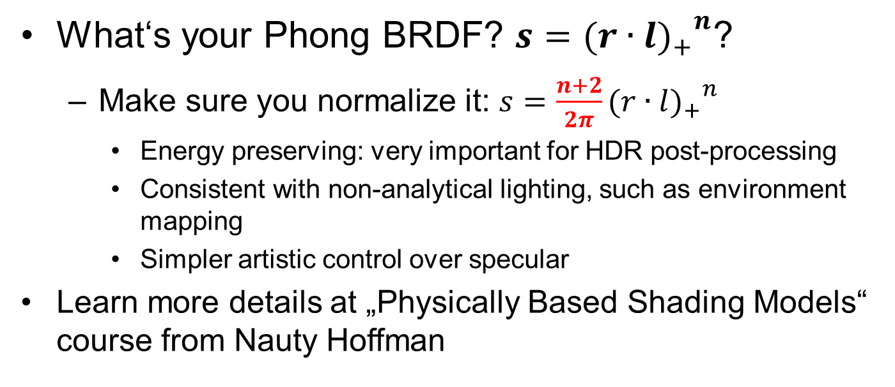
Lighting consistency: Phong BRDF
What‘s your Phong BRDF? $s={{(r∙l)}_{+}^{}}_{}^{n}$?
Make sure you normalize it: $s=\frac{n+2}{2π}{{(r∙l)}_{+}^{}}_{}^{n}$
Energy preserving: very important for HDR post-processing
Consistent with non-analytical lighting, such as environment mapping
Simpler artistic control over specular
Learn more details at „Physically Based Shading Models“ course from Nauty Hoffman
Notes:
It turned out that the section of this talk highly overlaps with the Physically based shading model” course presented at the same time at the SIGGRAPH:
http://renderwonk.com/publications/s2010-shading-course/hoffman/s2010_physically_based_shading_hoffman_b.pdf
I’d highly recommend to refer to this course in order to understand the advantages of BRDF normalization in more details and examples.
Briefly speaking, here are the most important ones:
Energy preserving: very important for HDR post-processing
Consistent with non-analytical lighting, such as environment mapping
Simpler artistic control over specular

Slide 52
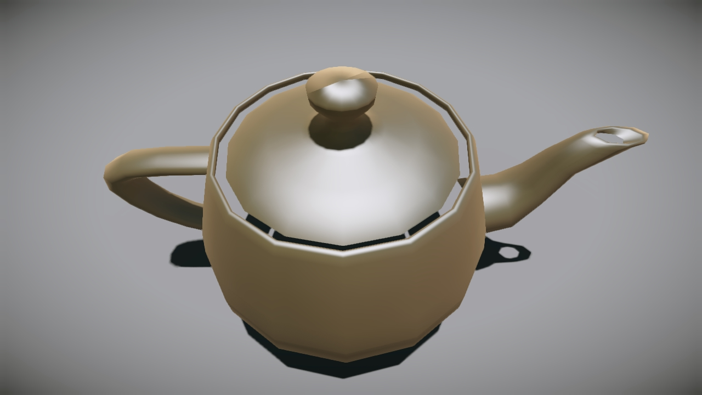
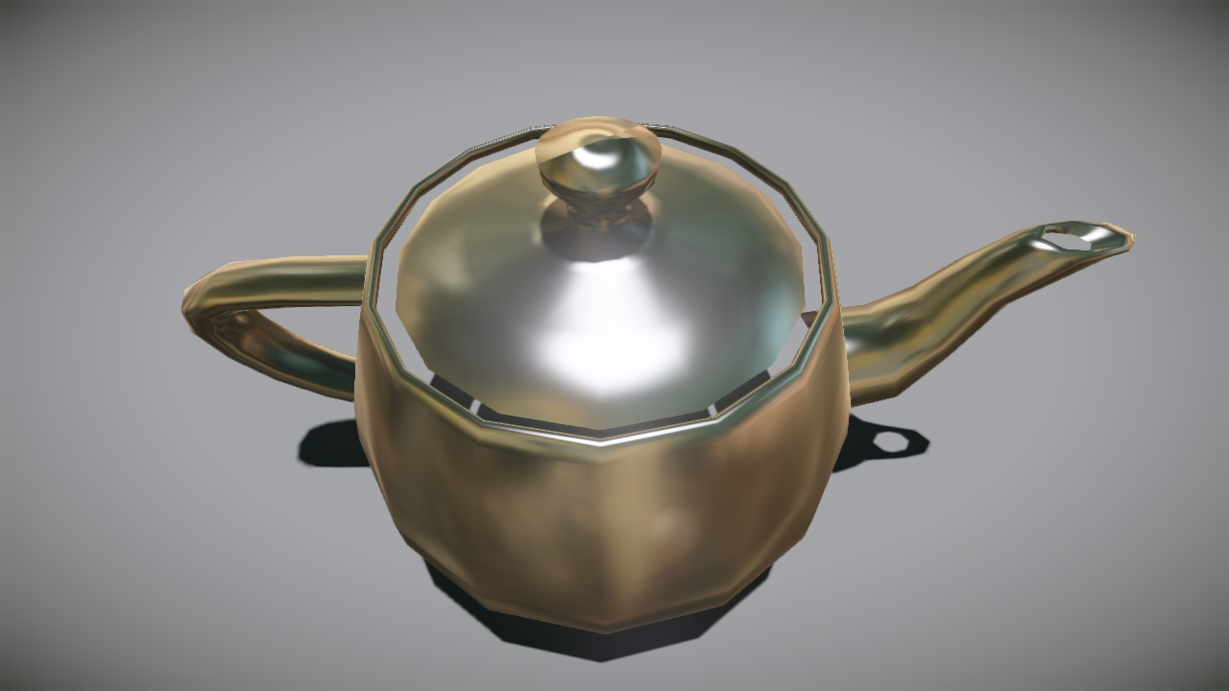
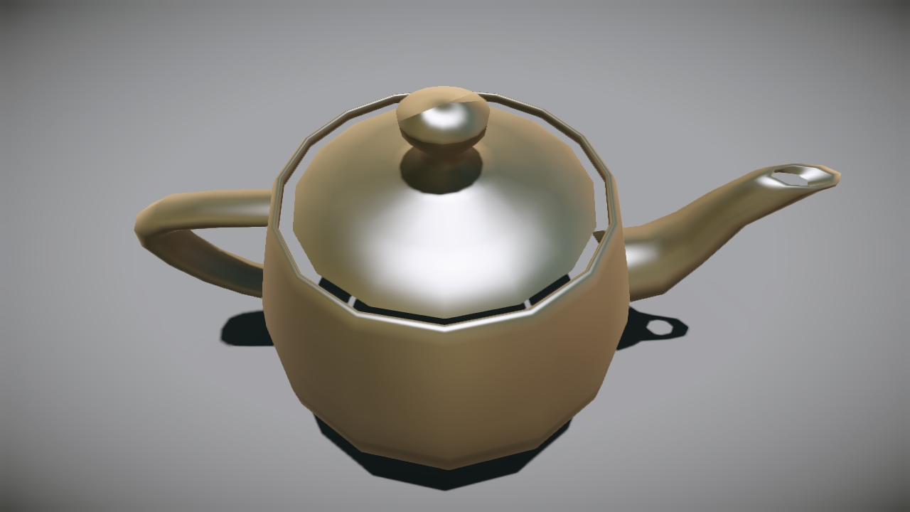
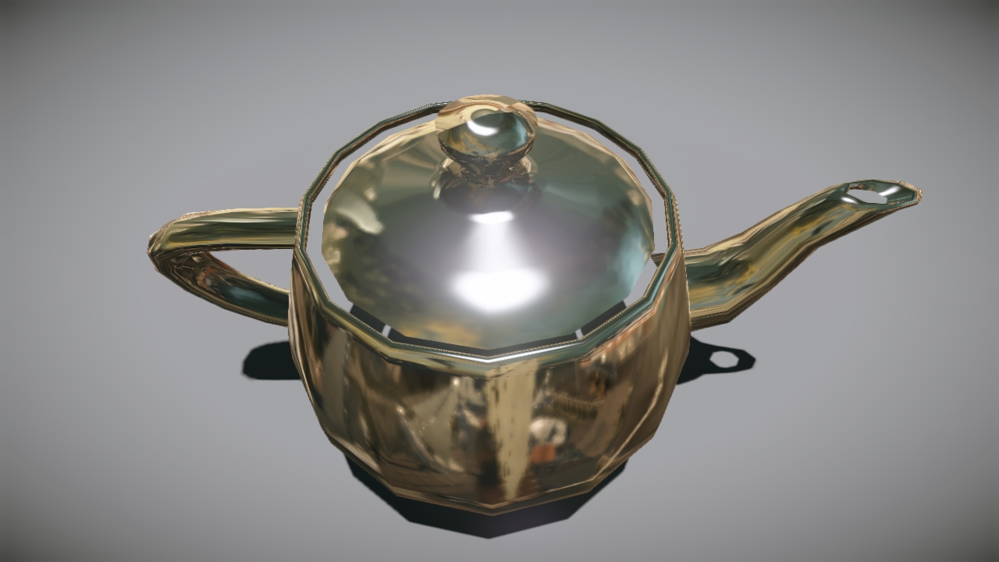
Consistent lighting example
Phong, glossiness = 5
Phong, glossiness = 120
Phong, glossiness = 20
Phong, glossiness = 250
Notes:
Here are the results for different glossiness values for Phong BRDF. The reflectance coefficient of the material remains the same in all images.
However please notice the intensity of analytic reflection coming from the sun and how consistent it is with the precomputed environment lighting.

Slide 53
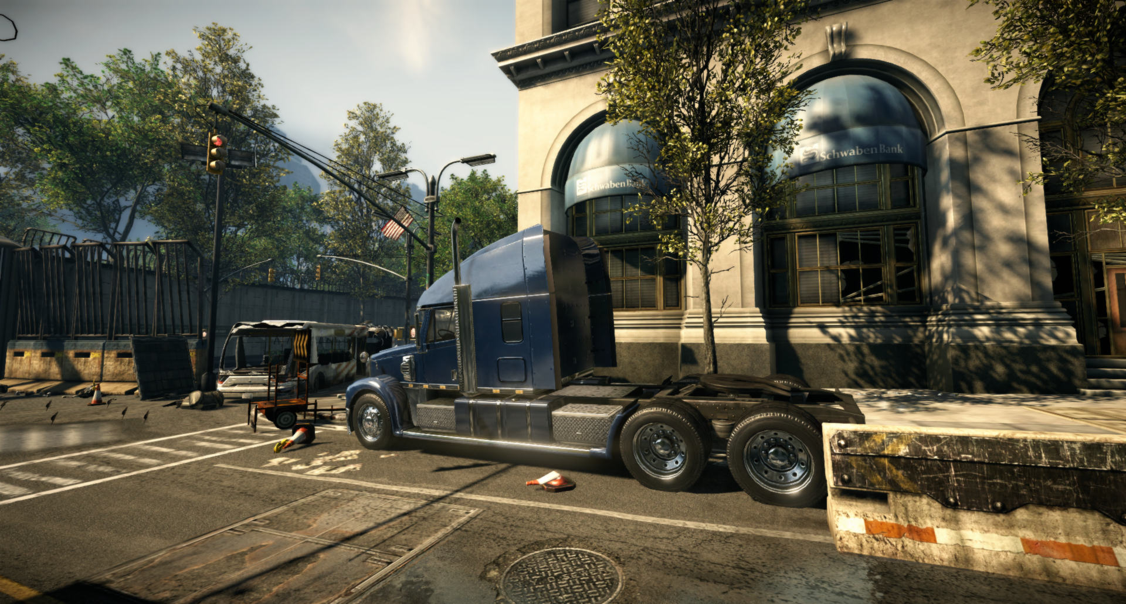
Consistent lighting example
Notes:
Here are some in-game examples of the consistency across the precomputed and analytical lighting.

Slide 54
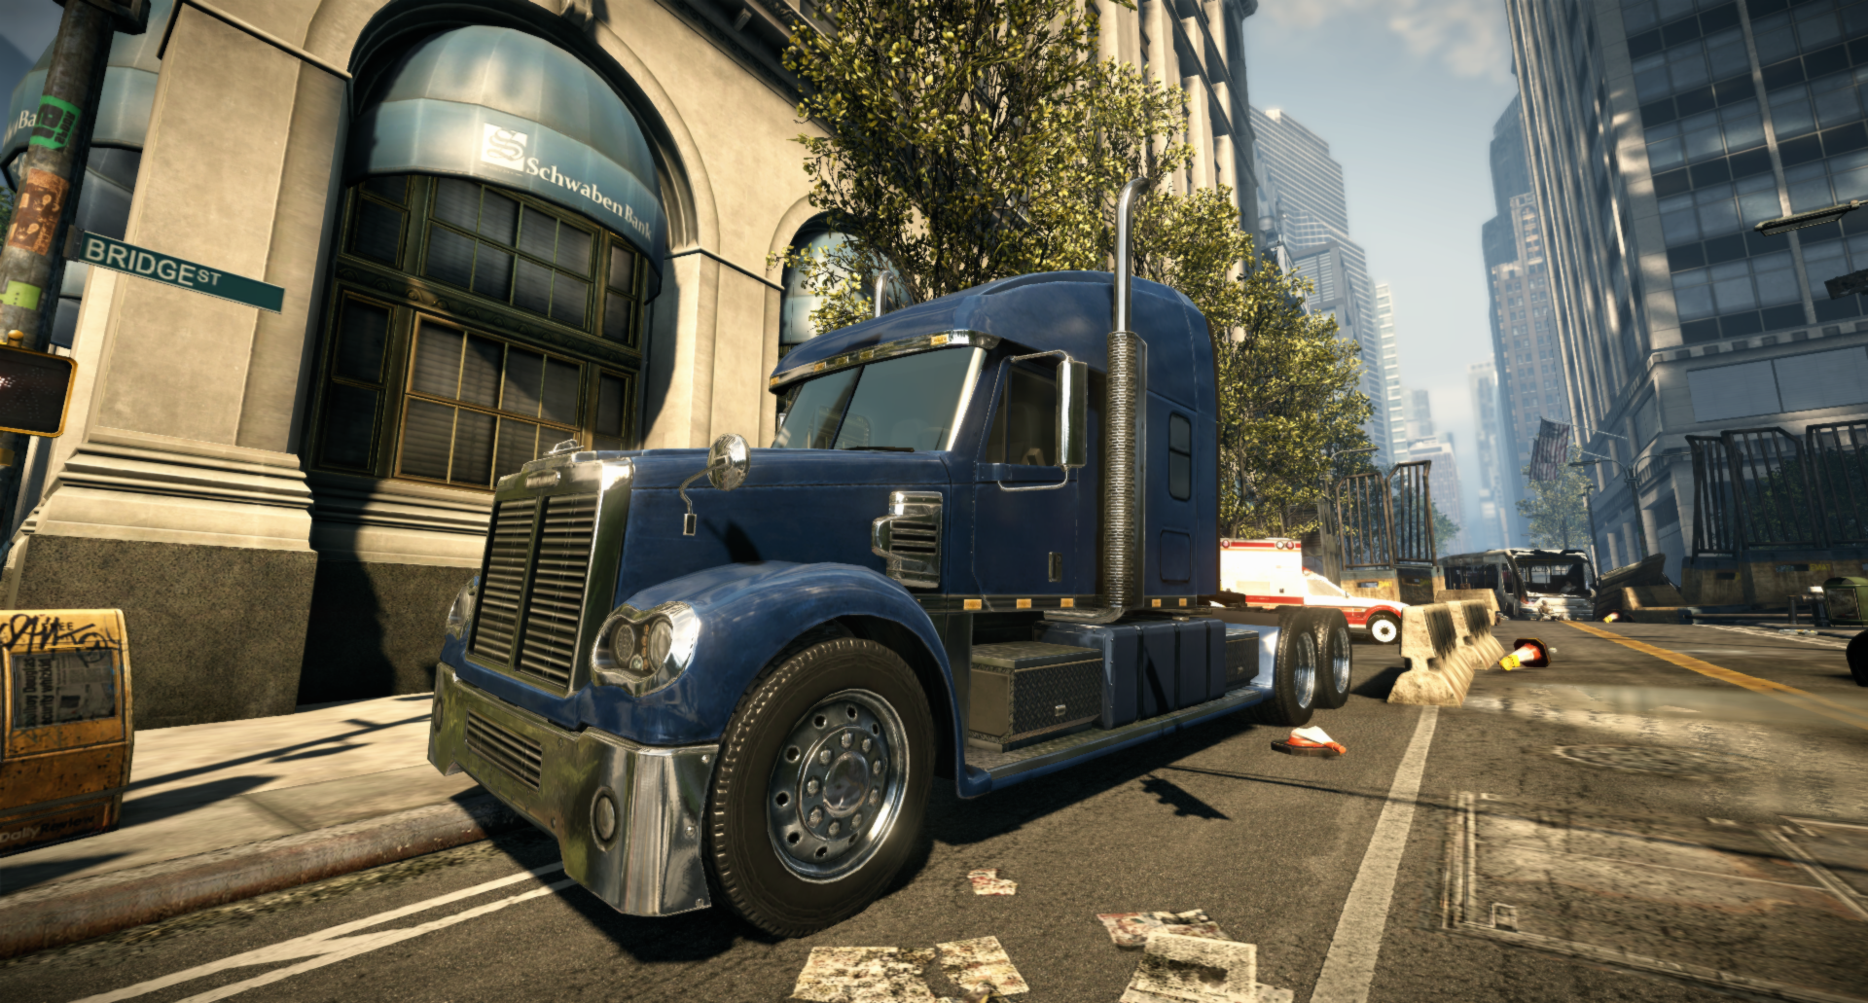
Consistent lighting example
Notes:
Here are some in-game examples of the consistency across the precomputed and analytical lighting.

Slide 55
HDR… VS bandwidth vs Precision
Notes:
This part of the talk is devoted to the low-bandwidth, high-quality HDR pipeline on consoles.

Slide 56
HDR on consoles
Can we achieve bandwidth the same as for LDR?
PS3: RGBK (aka RGBM) compression
RGBA8 texture – the same bandwidth
RT read-backs solves blending problem
Xbox360: Use R11G11B10 texture for HDR
Same bandwidth as for LDR
Remove _AS16 suffix for this format for better cache utilization
Not enough precision for linear HDR lighting!
Notes:
The ideal goal for us is to achieve the complete HDR rendering pipeline with no additional bandwidth or performance overhead.
Thus we came up with RGBK compression for all our HDR buffers on PS3. We use RGBA8 render targets for light accumulation buffers (both diffuse and specular) and for the final HDR shaded scene render target.
We use custom blending with read-backs on PS3 in order to achieve proper blending operations with RGBK encoding.
However it works unless you have some overlapped geometry to draw. This is the only case with transparent objects for us. So, as we draw transparent objects in the end, we decode the RGBK buffer into a fat ARGB16F render target before rendering any transparency. This provided a small overhead, as the decoding is conjoined with the full-screen global fog pass.
On the other hand there is no read-back capability on Xbox 360’s GPU. Thus we render the whole scene into an ARGB16 render target in the EDRAM and resolve it into an R11G11B10 texture in the system memory.
Thus the bandwidth outside EDRAM remains the same as for LDR rendering. The R11G11B10 format gets expanded into ARGB16 in the texture cache by default. To avoid that, we would recommend to remove _AS16 suffix from this format.
However even 11 bits per channel provide way too low storage precision for HDR lighting in linear space.

Slide 57
HDR on consoles: dynamic range
Use dynamic range scaling to improve precision
Use average luminance to detect the efficient range
Already computed from previous frame
Detect lower bound for HDR image intensity
The final picture is LDR after tone mapping
The LDR threshold is 0.5/255=1/510
Use inverse tone mapping as estimator
Notes:
Thus we decided to use a floating range window for HDR.
We define minimum and maximum values for HDR buffers and rescale all input light parameters on CPU before submitting it to the GPU.
The range window is based on the average frame luminance. The maximum value is adjusted empirically for each level.
However the lower bound can be computed analytically, based on the tone mapping operator in use.
The idea behind that is that the HDR image becomes LDR in order to be presented on the LDR display.
However the lower threshold for the majority of displays does not exceed 0.5/255.
Using this lower bound of the output color, we can apply an inverse tone mapping operator to it and find a minimum HDR value analytically.

Slide 58
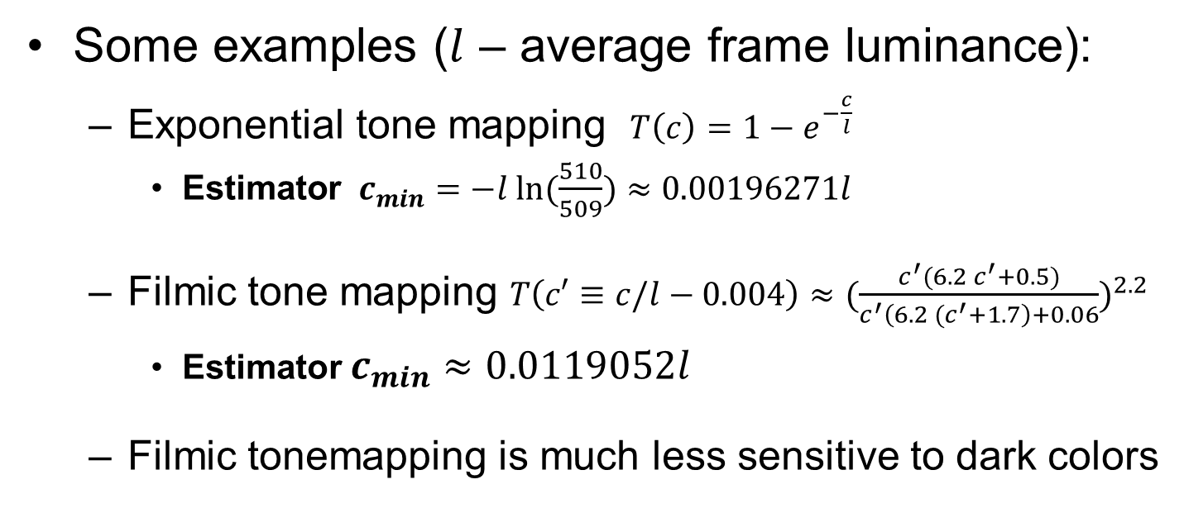
HDR on consoles: lower bound estimator
Some examples ($l$ – average frame luminance):
Exponential tone mapping $T\left(c\right)=1−e^{−\frac{c}{l}}$
$\text{Estimator} { c}_{min}=−l ln⁡(\frac{510}{509})≈0.00196271l$
Filmic tone mapping $T\left(c′≡c/l−0.004\right)≈({\frac{c^{′}(6.2 c^{′}+0.5)}{c^{′}\left(6.2 {(c}^{′}+1.7\right)+0.06})}^{2.2}$
Estimator $c_{min}≈0.0119052l$
Filmic tonemapping is much less sensitive to dark colors
Notes:
On this slide there are two tone mapping operators we use. The l is an average luminance in these equations. The c is an input HDR color.
We use value for l from previous frame, as it changes smoothly due to eye adaption.
The exponential tone mapping operator is very sensitive to dark colors.
However the filmic tone mapping operator is rather moderately tolerable to dark colors.

Slide 59
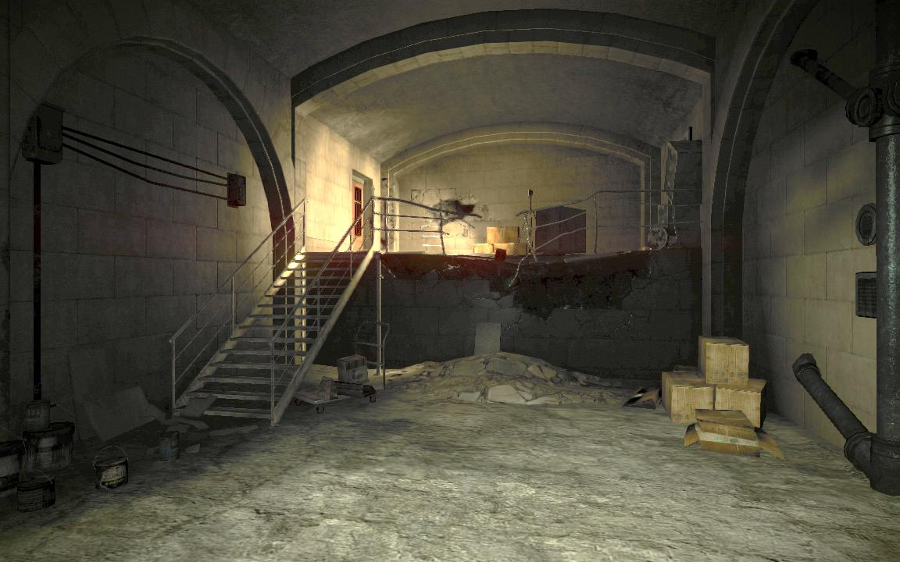
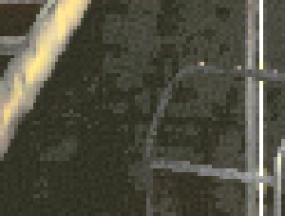
HDR dynamic range example
Dynamic range scaling is disabled
Notes:
Here are the resulting screenshots made on Xbox 360 with R11G11B10 HDR buffers.

Slide 60

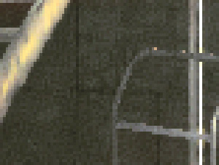
HDR dynamic range example
Dynamic range scaling is enabled
Notes:
Here are the resulting screenshots made on Xbox 360 with R11G11B10 HDR buffers.

Slide 61
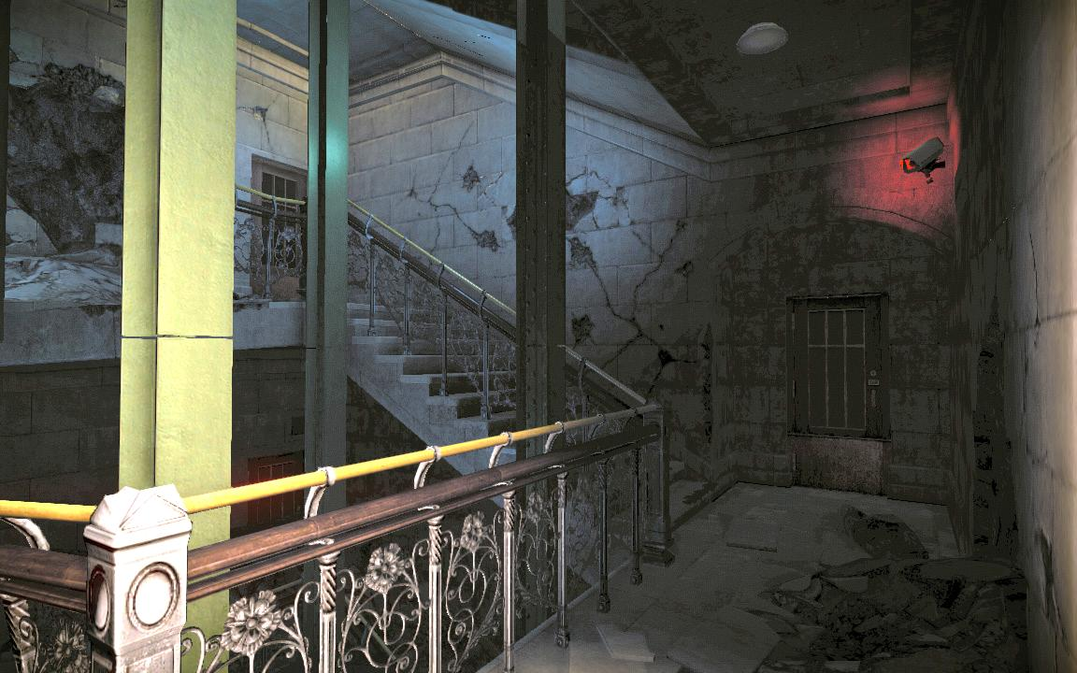
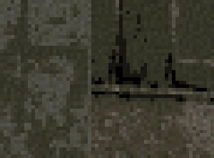
HDR dynamic range example
Dynamic range scaling is disabled
Notes:
Here are the resulting screenshots made on Xbox 360 with R11G11B10 HDR buffers.

Slide 62
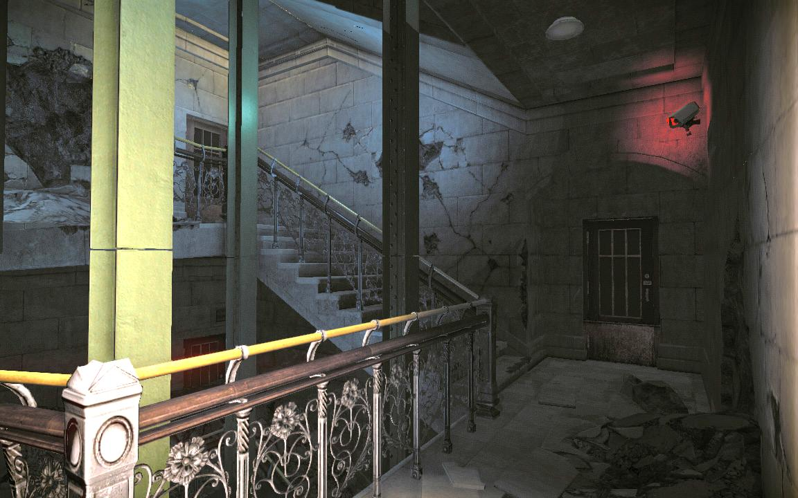
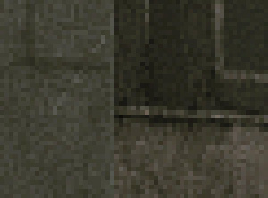
HDR dynamic range example
Dynamic range scaling is enabled
Notes:
Here are the resulting screenshots made on Xbox 360 with R11G11B10 HDR buffers.

Slide 63
Lighting tools: Clip volumes
Notes:
This small section is devoted to rather small, but extremely powerful concept of tagging areas and volumes with deferred pipeline.

Slide 64
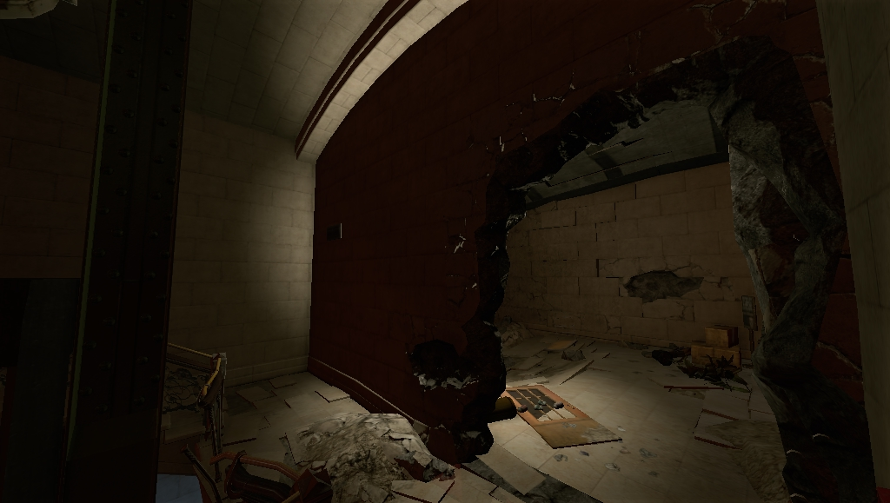
Clip Volumes for Deferred Lighting
Deferred light source w/o shadows tend to bleed:
Shadows are expensive
Solution: use artist-defined clipping geometry: clip volumes
Mask the stencil in addition to light volume masking
Very cheap providing fourfold stencil tagging speed
Light source is
behind the wall
Notes:
There is a common problem of light bleeding become apparent with the deferred approach: the boundaries of lighting are not controllable.
E.g. the deferred light placed in one room can bleed through the wall into another room.
Thus we decided to provide a tool for artists that they can specify a custom stencil culling geometry for each light source in the scene.
This approach is very cheap provided that the clipping geometry is rather coarse and the stencil tagging is very fast on consoles.

Slide 65
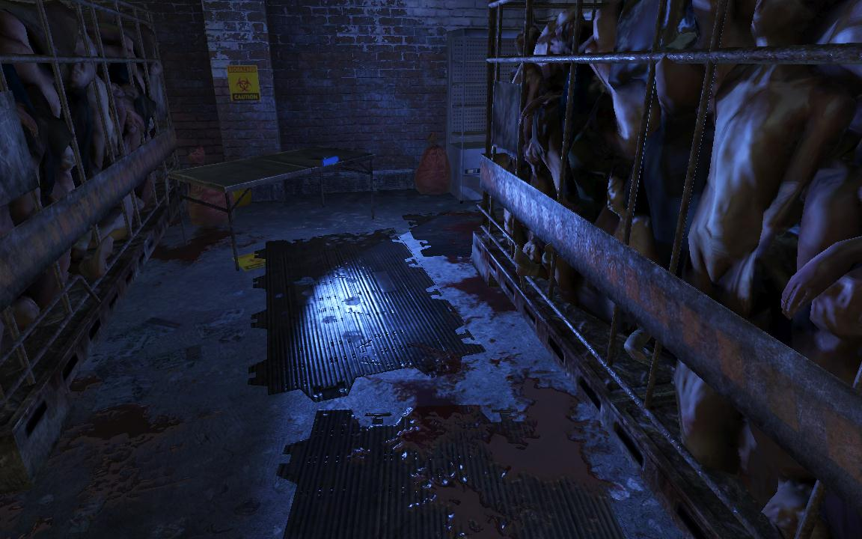
Clip Volumes example
Example scene
Notes:
This is an example of how the clip volume works for some particular light.

Slide 66

Clip Volumes example
Clip volume geometry
Notes:
This is an example of how the clip volume works for some particular light.

Slide 67

Clip Volumes example
Stencil tagging
Notes:
This is an example of how the clip volume works for some particular light.

Slide 68

Clip Volumes example
Light Accumulation Buffer
Notes:
This is an example of how the clip volume works for some particular light.

Slide 69
Clip Volumes example
Final result
Notes:
This is an example of how the clip volume works for some particular light.

Slide 70
Deferred lighting and Anisotropic materials
Notes:
This part of the talk is devoted to the problem of materials variety with deferred pipeline.

Slide 71
Anisotropic deferred materials
G-Buffer stores only normal and glossiness
That defines a BRDF with a single Phong lobe
We need more lobes to represent anisotropic BRDF
Could be extended with fat G-Buffer (too heavy for production)
Consider one screen pixel
We have normal and view vector, thus BRDF is defined on sphere
Do we need all these lobes to illuminate this pixel?
Lighting distribution is unknown though
Notes:
The core idea is preserve the current bandwidth and interfere with the deferred pipeline as less as possible.
The current G-Buffer layout can store only a Phong BRDF as it was mentioned before.
However in order to represent a complex BRDF, such as a highly anisotropic Ward BRDF, we need much more lobes. This can be implemented by expanding the G-Buffer layout and adding more information about BRDF.
However the whole lighting pipeline would suffer from that. Moreover, taking into account the complex layered lighting and increasing data size stored in G-Buffer per pixel, the bandwidth grows too quickly. This fact makes this approach unaffordable for the actual game production.
However if we consider one pixel of the G-Buffer, we know a lot of fixed parameters, such as normal, view direction etc. (note that for a given particular pixel it is fixed and known at the G-Buffer generation time). Thus the BRDF can be defined as a function on the sphere.
But something that is unknown at that time for us is lighting conditions.

Slide 72


Anisotropic deferred materials, part I
Idea: Extract the major Phong lobe from NDF
Use microfacet BRDF model [CT82]:
Fresnel and geometry terms can be deferred
Lighting-implied BRDF is proportional to the NDF:
Approximate NDF with Spherical Gaussians [WRGSG09]
Need only ~7 lobes for Anisotropic Ward NDF
$$ρ\left(x,o,i\right)=\frac{D\left(x,h\right)S\left(x,o\right)S\left(x,i\right)F(x,o,i)}{4(i∙n)(o∙n)}$$
$$ρ\left(x,o,i\right)\sim D\left(x,h\right)$$
Notes:
So the general idea behind the approach is to do a Phong lobe extraction at the G-Buffer generation time.
There are several advantages:
G-Buffer layout, memory footprint and bandwidth remains the same!
Support for arbitrary type and complexity of BRDF
Completely orthogonal and transparent for the subsequent lighting pass
First, consider a microfacet BRDF model.
The Fresnel and geometry terms of this model can be completely decoupled from lighting and applied in a subsequent shading pass per object.
Thus the part of BRDF that affects the lighting directly and cannot be decoupled from the lighting pass, is the Normal Distribution Function.
We approximate the NDF of the BRDF with Spherical Gaussians in spirit of [WRGSG09]. Note that most of common BRDFs have analytical formulas for this basis. Another important fact is the compactness of the representation. E.g. anisotropic Ward BRDF can be represented by only 7 basis functions in a vast majority of cases.

Slide 73
Anisotropic deferred materials, part II
Approximate lighting distribution with SG per object
Merge SG functions if appropriate
Prepare several approximations for huge objects
Extract the principal Phong lobe into G-Buffer
Convolve lobes and extract the mean normal (next slide)
Do a usual deferred Phong lighting
Do shading, apply Fresnel and geometry term
Notes:
After we’ve got a compact representation of the BRDF for current screen pixel, we can extract the principal Phong lobe out of it.
In order to do that, we need to know lighting conditions for this pixel.
We approximate the lighting conditions with Spherical Gaussians per object.
The approximation is done on CPU. Similar lobes can be merged together at this time in order to minimize the representation.
If an object is huge or long, we can prepare several lighting representations in different places of the object and interpolate between them in the vertex shader.
So in order to extract the Phong lobe, we convolve each SG function of the BRDF representation with each SG function of the lighting representation. We use the result to weight the normal and fit the glossiness factor after each convolution.
Note that the SG basis is not orthogonal, so the cost is polynomial O(n*m), where n is number of basis function representing lighting and m is the number of function of BRDF representation.
After the normal and the glossiness are extracted, we output it as a usual Phong lobe into G-Buffer.
Then we do a usual deferred Phong lighting with many lights. Note that normals and glossiness are already adjusted to best approximate the BRDF by a Phong BRDF for each particular pixel.
Thus the variety of BRDFs becomes completely invisible at the deferred lighting stage. That fact itself unifies the pipeline and has a very positive performance implications.
And we apply the Fresnel and geometry term in the end after the lighting is done.

Slide 74
Extracting the principal Phong lobe
CPU: prepare SG lighting representation per object
Vertex shader:
Rotate SG representation of BRDF to local frame
Cut down number of lighting SG lobes to ~7 by hemisphere
Pixel shader:
Rotate SG-represented BRDF wrt tangent space
Convolve the SG BRDF with SG lighting
Compute the principal Phong lobe and output it
Notes:
So, the extraction pipeline is as follows:
CPU: Approximate lighting conditions with SG for each object (e.g. in object’s center or multiple points)
Vertex shader:
generate SG coefficients for BRDF representation
Cull invisible SG lobes of lighting representation (based on hemisphere of visibility)
Pixel shader:
Do a local rotation of BRDF based on normal maps (if any)
Convolve each SG of BRDF with each SG of lighting representation
Accumulate principal Phong lobe and output it

Slide 75

Anisotropic deferred materials
$$ρ\left(x,o,i\right)=\frac{D\left(x\right)S\left(x,o\right)S\left(x,i\right)F(x,o,i)}{4(i∙n)(o∙n)}$$
Norma Distribution Function
Fresnel + Geometry terms
Phong lobe extraction
G-Buffer generation
Deferred lighting
Final shading
Notes:
This is a diagram of decoupling the BRDF complexity from the lighting complexity.
As you can see, the BRDF complexity is completely eliminated from the lighting pass.

Slide 76

Anisotropic deferred materials
Anisotropic materials with deferred lighting
Notes:
This is an example of the technology at work

Slide 77

Anisotropic deferred materials
Normals buffer after principal lobe extraction
Notes:
This is an example of the technology at work

Slide 78
Anisotropic deferred materials: why?
Cons:
Imprecise lobe extraction and specular reflections
But: see [RTDKS10] for more details about perceived reflections
Two lighting passes per pixel?
But: hierarchical culling for prelighting: Object → Vertex → Pixel
Pros:
No additional information in G-Buffer: bandwidth preserved
Transparent for subsequent lighting pass
Pipeline unification: shadows, materials, shader combinations
Notes:
There are several obvious disadvantages of this technique:
Lobes are extracted not precisely. Specular highlight appears slightly shifted due to per-object lighting approximation
However this turns out to be a rather small issue due to the human perception limitations. Please see [RTDKS10] for more details.
Essentially we do the lighting twice: the first time during the G-Buffer generation pass, and the second time is the actual deferred lighting.
However the first pass is hierarchical with merging and culling. And it is executed only for pixels covered by objects with complex BRDF, which is a reasonable cost.
Besides that, there are several obvious advantages of the technique:
The G-Buffer remains the same!
The lighting pipeline is unchanged.
The materials pipeline stays unified, as deferred lights can be applied in-place for objects with arbitrary BRDFs. That means we don’t need to shade it separately in forward pass; we don’t need to store all shadow maps and compute many shader permutations for forward shading with different number and types of light sources etc.

Slide 79
Deferred Lighting and Anti-aliasing
Notes:
This part of the talk is devoted to the aliasing problem in deferred pipeline and the proposed solution to it.

Slide 80
Aliasing sources
Coarse surface sampling (rasterization)
Saw-like jaggy edges
Flickering of highly detailed geometry (foliage, gratings, ropes etc.) because of sparse sampling
Any post MSAA (including MLAA) won‘t help with that
More aliasing sources
Sparse shading
Sudden spatial/temporal shading change
Sparse lighting etc.etc.
Notes:
There are multiple sources of aliasing in rendering pipeline.
Some aliasing artifacts such as jaggy edges can be addressed with some postprocessing techniques, such as Morphological Anti-Aliasing.
However there are some fundamentally different sources of aliasing that cannot be solved by postprocessing, as it require supersampling.
E.g. flickering of highly discontinuous geometry such as foliage or thin ropes are caused by per-screen-pixel visibility resolution, which is considered too sparse for such kind of geometry. So in this case the visibility should be resolved at higher resolution with some supersampling technique.
Another source of aliasing can be discontinuities in shading, e.g. reflections of high-frequency or discontinuous shadows etc. This means we need to supersample the shading per pixel for.

Slide 81
Hybrid anti-aliasing solution
Post-process AA for near objects
Doesn‘t supersample
Works on edges
Temporal AA for distant objects
Does temporal supersampling
Doesn‘t distinguish surface-space shading changes
Separate it with stencil and non-jitterred camera
Notes:
However we noticed that in the majority of scenes, the supersampling is required mostly only for distant objects, where the GPU fails to approximate shading/mip-mapping/visibility per pixel.
Thus we propose a hybrid solution that solves different aliasing problems based on the distance to camera (some other parameters could be taken into account as well though).
We apply a post-processing edge-detection algorithm on close-up objects. That solves the problem with edges. Note that there is almost no supersampling required for near objects, as they are sampled and shaded at sufficient rate in screen space.
We supplement it with temporal supersampling based on reprojection of previous results. This temporal supersampling is done only for distant objects.
We render different parts of the scene with different techniques and separate it with stencil masking.

Slide 82

Post-process Anti-Aliasing
We decided not to invest compute power to MLAA
Doesn‘t remove aliasing completely anyway
There are cheaper ways to blur edges
We use very simple yet efficient filter
Compute color deviation: $d=\sum_{adj}{\left|s_{i}−s_{0}\right|}$
Blur current pixel based on deviation from current color
Use only 4 adjacent samples
Take into accound all 8 adjacent pixels with bilinear interpolation
Notes:
As the edge-detection algorithm needs to smooth the shapes of close-up objects only. Thus we decided to make it as simple as possible.
So we compute the color deviation from 8 surrounding screen pixels in 4 lookups with bilinear filtering and then decide how strong the current pixel should be blurred.

Slide 83
Temporal Anti-Aliasing
Use temporal reprojection with cache miss approach
Store previous frame and depth buffer
Reproject the texel to the previous frame
Assess depth changes
Do an accumulation in case of small depth change
Use sub-pixel temporal jittering for camera position
Take into account edge discontinuities for accumulation
See [NVLTI07] and [HEMS10] for more details
Notes:
We use screen-space sub-pixel temporal camera jittering. That means we shift the camera position with a subsample pattern in screen space for each frame. So for still camera we can accumulate sub-pixel supersampling over time.
In case of dynamic objects and/or camera movements, we use cache miss philosophy based on the depth changes across frames.
In order to accumulate super-sampled visibility on the edges, we check for depth discontinuities in the frame’s depth buffer.
Please see [NVLTI07] and [HEMS10] for more details.

Slide 84
Hybrid anti-aliasing solution
Separation by distance guarantees small changes of view vector for distant objects
Reduces the fundamental problem of reverse temporal reprojection: view-dependent changes in shading domain
Separate on per-object base
Consistent object-space shading behavior
Use stencil to tag an object for temporal jittering
Notes:
The reason is that the reprojection in it is based on the depth buffer. Thus it is impossible to take into account shading-space local changes on objects. That might lead to ghosting shadows, reflections and so on, if we apply it onto close-up objects.

Slide 85



Hybrid anti-aliasing example
Notes:
This image shows two parts of the scene (“close-up” case and “distant” case) and demonstrates how different techniques are applied onto different parts of the scene.
Please watch the supplementary video for more details.

Slide 86


Hybrid anti-aliasing example
Notes:
This image shows two parts of the scene (“close-up” case and “distant” case) and demonstrates how different techniques are applied onto different parts of the scene.
Please watch the supplementary video for more details.

Slide 87


Hybrid anti-aliasing example
Notes:
This image shows two parts of the scene (“close-up” case and “distant” case) and demonstrates how different techniques are applied onto different parts of the scene.
Please watch the supplementary video for more details.

Slide 88

Temporal AA contribution
Notes:
This image shows two parts of the scene (“close-up” case and “distant” case) and demonstrates how different techniques are applied onto different parts of the scene.
Please watch the supplementary video for more details.

Slide 89

Edge AA contribution
Notes:
This image shows two parts of the scene (“close-up” case and “distant” case) and demonstrates how different techniques are applied onto different parts of the scene.
Please watch the supplementary video for more details.

Slide 90
Hybrid anti-aliasing video
Notes:
Please watch the supplementary video for more details.

Slide 91
Conclusion
Texture compression improvements for consoles
Deferred pipeline: some major issues successfully resolved
Bandwidth and precision
Anisotropic materials
Anti-aliasing
Please look at the full version of slides (including texture compression) at: http://advances.realtimerendering.com/
Notes:
Improvements to textures quality on consoles was proposed.
We demonstrated a few solutions to several fundamental problems of deferred lighting.

Slide 92
Acknowledgements
Vaclav Kyba from R&D for implementation of temporal AA
Tiago Sousa, Sergey Sokov and the whole Crytek R&D department
Carsten Dachsbacher for suggestions on the talk
Holger Gruen for invaluable help on effects
Yury Uralsky and Miguel Sainz for consulting
David Cook and Ivan Nevraev for consulting on Xbox 360 GPU
Phil Scott, Sebastien Domine, Kumar Iyer and the whole Parallel Nsight team
Notes:
I’d like to thank all these people as well as Crytek GmbH for providing me the information and time do prepare this talk!

Slide 93
Questions?
Thank you for your attention
Notes:
??

Slide 94
Appendix A: best fit for normals

Slide 95
Function to find minimum error:
float quantize255(float c)
{
float w = saturate(c * .5f + .5f);
float r = round(w * 255.f);
float v = r / 255.f * 2.f - 1.f;
return v;
}
float3 FindMinimumQuantizationError(in half3 normal)
{
normal /= max(abs(normal.x), max(abs(normal.y), abs(normal.z)));
float fMinError = 100000.f;
float3 fOut = normal;
for(float nStep = 1.5f;nStep <= 127.5f;++nStep)
{
float t = nStep / 127.5f;
// compute the probe
float3 vP = normal * t;
// quantize the probe
float3 vQuantizedP = float3(quantize255(vP.x), quantize255(vP.y), quantize255(vP.z));
// error computation for the probe
float3 vDiff = (vQuantizedP - vP) / t;
float fError = max(abs(vDiff.x), max(abs(vDiff.y), abs(vDiff.z)));
// find the minimum
if(fError < fMinError)
{
fMinError = fError;
fOut = vQuantizedP;
}
}
return fOut;
}

Slide 96

Cubemap produced with this function

Slide 97
Extract unique part
Consider one face, extract non-symmetric part into 2D texture
Also divide y coordinate by x coordinate to expand the triangle to quad
To download this texture look at: http://advances.realtimerendering.com/
Notes:
The texture can be copied over from this slide or downloaded from http://advances.realtimerendering.com/
Note that the 8-bits precision is sufficient if the best fit length is stored for the normal divided by maximum component.

Slide 98
Function to fetch 2D texture at G-Buffer pass:
void CompressNormalToUnsignedGBuffer(inout half4 vNormal)
{
// renormalize (needed only if any blending or interpolation happened before)
vNormal.rgb = normalize(vNormal.rgb);
// get unsigned normal for the cubemap lookup
half3 vNormalUns = abs(vNormal.rgb);
// get the main axis for cubemap lookup
half maxNAbs = max(vNormalUns.z, max(vNormalUns.x, vNormalUns.y));
// get texture coordinates in a collapsed cubemap
float2 vTexCoord = vNormalUns.z<maxNAbs?(vNormalUns.y<maxNAbs?vNormalUns.yz:vNormalUns.xz):vNormalUns.xy;
vTexCoord = vTexCoord.x < vTexCoord.y ? vTexCoord.yx : vTexCoord.xy;
vTexCoord.y /= vTexCoord.x;
// fit normal into the edge of unit cube
vNormal.rgb /= maxNAbs;
// look-up fitting length and scale the normal to get the best fit
half fFittingScale = tex2D(normalsSampler2D, vTexCoord).a;
// scale the normal to get the best fit
vNormal.rgb *= fFittingScale;
// wrap to [0;1] unsigned form
vNormal.rgb = vNormal.rgb * .5h + .5h;
}
Notes:
Note that the G-Buffer pass is usually bound by vertex processing, so

Slide 99
References
[CT81] Cook, R. L., and Torrance, K. E. 1981. “A reflectance model for computer graphics”, SIGGRAPH 1981
[HEMS10] Herzog, R., Eisemann, E., Myszkowski, K., Seidel, H.-P. 2010. “Spatio-Temporal Upsampling on the GPU” I3D 2010.
[LS10] Loos, B.J. and Sloan, P.-P. 2010 “Volumetric Obscurance”, I3D symposium on interactive graphics, 2010
[NVLTI07] Nehab, D., Sander, P., Lawrence, J., Tatarchuk, N., Isidoro, J. 2007. “Accelerating Real-Time Shading with Reverse Reprojection Caching”, Conference On Graphics Hardware, 2007
[RTDKS10] T. Ritschel, T. Thormählen, C. Dachsbacher, J. Kautz, H.-P. Seidel, 2010. “Interactive On-surface Signal Deformation”, SIGGRAPH 2010
[SELAN07] Selan, J. 2007. “Using Lookup Tables to Accelerate Color Transformations”, GPU Gems 3, Chapter 24.
[WRGSG09] Wang., J., Ren, P., Gong, M., Snyder, J., Guo, B. 2009. “All-Frequency Rendering of Dynamic, Spatially-Varying Reflectance”, SIGGRAPH Asia 2009

